Slide 1
Week7
김예진
2021.8.20

Slide 2
Validation 경과 시간
202,520 amount of validation captions , csv에 저장된 count 마지막 숫자 202625 , 202654.
587s / 202654 = 2.896ms
Notes:
https://mobicon.tistory.com/537 -> 사진 참조
1) validate() 에서 val 데이터셋에서 prediction한 문장 hypothesis와 score 결과를 저장하고, 상위 10%, 하위10% 출력

Slide 3
Validate bleu1 - top 10 / bottom 10
0 | 1 | 2
1 | a man riding a wave on top of a surfboard . | a man riding a wave on top of a surfboard .
1 | a man is flying a kite on the beach . | a man is flying a kite on the beach .
1 | a giraffe standing next to a tree in a forest . | a giraffe standing next to a tree in a forest .
1 | a man riding a skateboard down a ramp . | a man riding a skateboard down a ramp .
1 | a man holding a tennis racquet on a tennis court . | a man holding a tennis racquet on a tennis court .
1 | a baseball player swinging a bat at a ball | a baseball player swinging a bat at a ball
1 | a man riding a wave on top of a surfboard . | a man riding a wave on top of a surfboard .
1 | a red double decker bus driving down a street . | a red double decker bus driving down a street .
1 | a man riding skis down a snow covered slope . | a man riding skis down a snow covered slope .
0.5 | a signs on <unk> crossing to a pole post . | street signs warning people attached to a lamp post .
0.5 | a group of teddy bears sitting are been on them | a couple of teddy bears that have cloths on
0.5 | a man player is swinging a the field . his bat ball . . | a baseball player is striking on the bat with a base ball game
0.5 | a man in a sheep of of a sheep . | a man shearing the wool off of a sheep
0.5 | a traffic light with a pole pole next a street . a a building building . | a street light on a metal pole above a street and before a red house .
0.071429 | a image man man is in in is teeth <unk> . . . . | an old white guy is happy that his first surfing adventure went well
0.071429 | a and a umbrellas on on on a middle . a building of . | paper and decorative items now litter in the square following the russian olympics
0.071429 | a intersection with a with with with a traffic . a traffic . . | an intersection on bill <unk> street by the entrance for the train station
0.066667 | a is hand <unk> <unk> make a scissors with and be a . bread . | it 's not unusual to use giant kitchen shears to cut pieces of chicken .
0.066667 | a woman woman girl woman posing next a outdoor . . a . a . | a cute little oriental couple standing at an air port with cameras and smiling
0.066667 | a train soaked a of a a side a a of . <unk> . . | short rain as view from above either from over view mountain or air craft .
0.066667 | a people are hats colored shirts hats are a a near a umbrella umbrella . | two men wearing bright yellow construction jackets eating and standing under an orange umbrella
0.0625 | a in a and in a sides in in to a . a . the . | woman with oven mitts on both hands standing next to oven with pizza on top
0.0625 | a is two image of the . the . . . . . be . . | there are no images to describe ; <unk> it <unk> eight words to move on .
0.052632 | a a a a tennis tennis of tennis tennis of are of be <unk> he on a tennis are | to keep up with the action , the media people need to be as fast as the players .
Notes:
https://mobicon.tistory.com/537 -> 사진 참조
1) validate() 에서 val 데이터셋에서 prediction한 문장 hypothesis와 score 결과를 저장하고, 상위 10%, 하위10% 출력

Slide 4
Validate bleu4 - top 10 / bottom 10
0 | 1 | 2
1 | a dog is looking out the window of a car . | a dog is looking out the window of a car .
1 | a yellow boat sitting on top of a sandy beach . | a yellow boat sitting on top of a sandy beach .
1 | a herd of elephants walking across a lush green field . | a herd of elephants walking across a lush green field .
1 | a laptop computer sitting on top of a desk . | a laptop computer sitting on top of a desk .
1 | a man holding a tennis racquet on a tennis court . | a man holding a tennis racquet on a tennis court .
1 | a large jetliner sitting on top of an airport runway . | a large jetliner sitting on top of an airport runway .
1 | a man riding a snowboard down a snow covered slope . | a man riding a snowboard down a snow covered slope .
1 | a man riding a wave on top of a surfboard . | a man riding a wave on top of a surfboard .
1 | a man standing on a tennis court holding a racquet . | a man standing on a tennis court holding a racquet .
2.23E-308 | a man riding is riding a wave wave wave . the ocean . | a surfer that is riding a really big wave in the ocean .
2.23E-308 | a woman holding a blue shirt and playing a tennis racket . | a woman in a blue shirt is holding a tennis racquet .
2.23E-308 | a cat sitting on a next plant in a window . | a cat sitting in s potted plant by a window .
2.23E-308 | a television on with on a wall in to a tv . | a monitor screen mounted on a wall next to the entrance
2.23E-308 | a yellow is down to a platform on a picture . | a train coming closer to the person taking the picture .
2.23E-308 | a man in a soccer ball on a field field . | a man kicking a soccer ball across a green field .
2.23E-308 | a trees in in a wooded in by trees . | various animals graze in a pasture surrounded by woods .
2.23E-308 | a teddy bear is on a computer and a . | a teddy bear sits by a keyboards and microphone .
2.23E-308 | a small is flying on the colors . the . | the airplane is painted with special logos and symbols .
2.23E-308 | a man in in a frisbee holding holding a frisbee . | a man standing by a fence while throwing a frisbee
Notes:
https://mobicon.tistory.com/537 -> 사진 참조
1) validate() 에서 val 데이터셋에서 prediction한 문장 hypothesis와 score 결과를 저장하고, 상위 10%, 하위10% 출력

Slide 5
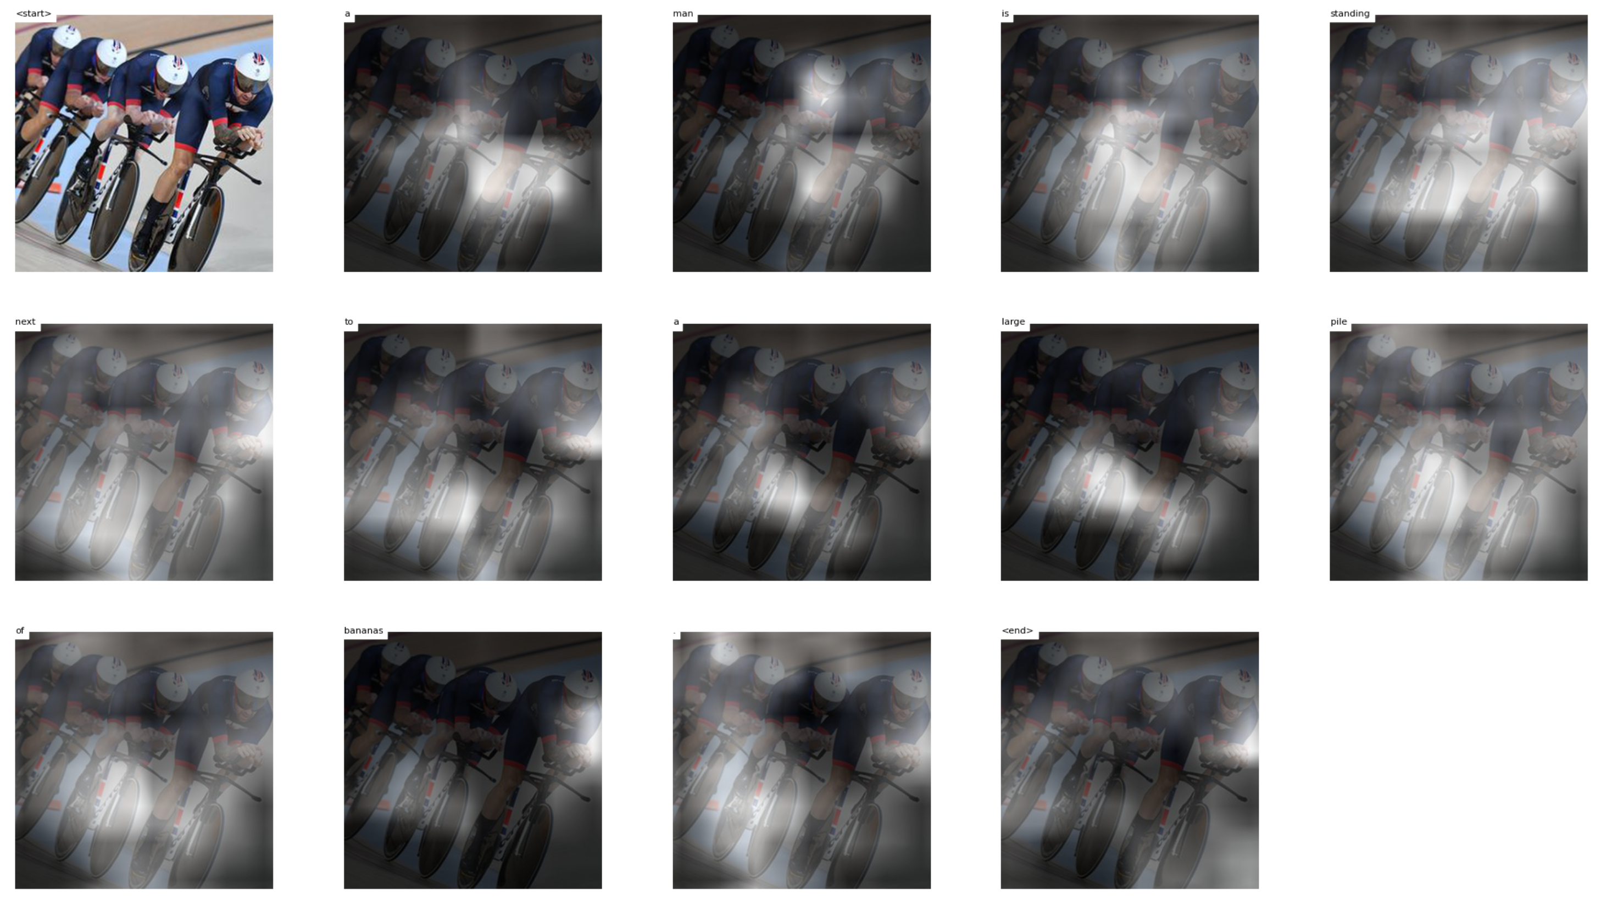
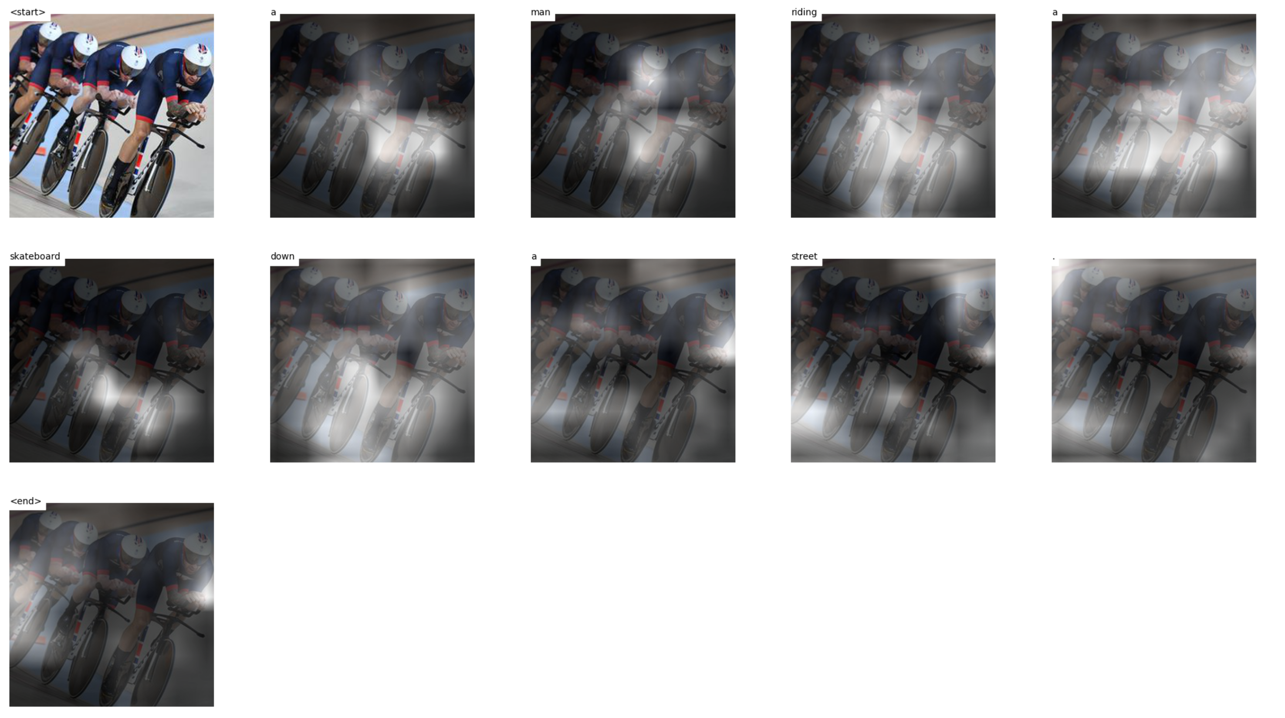
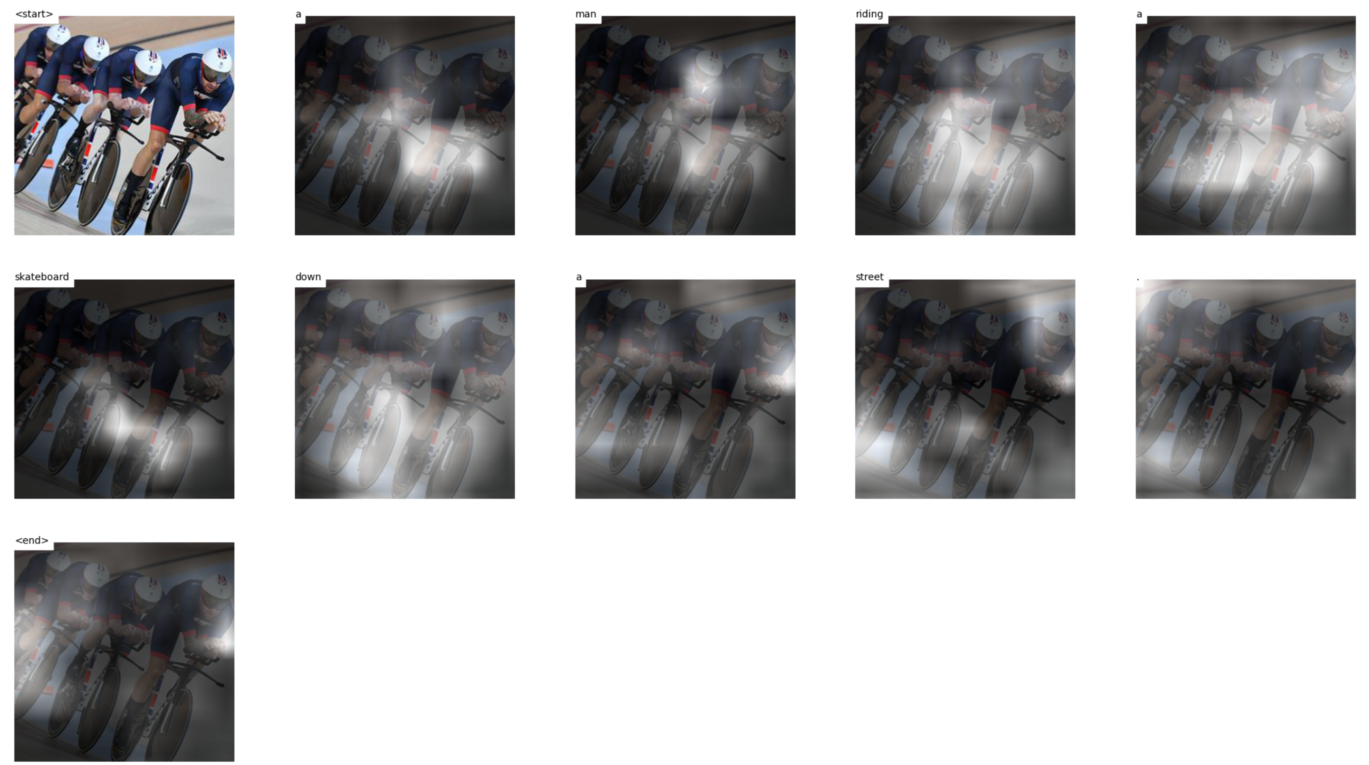
Test 10 images
Notes:
https://mobicon.tistory.com/537 -> 사진 참조
1) validate() 에서 val 데이터셋에서 prediction한 문장 hypothesis와 score 결과를 저장하고, 상위 10%, 하위10% 출력

Slide 6
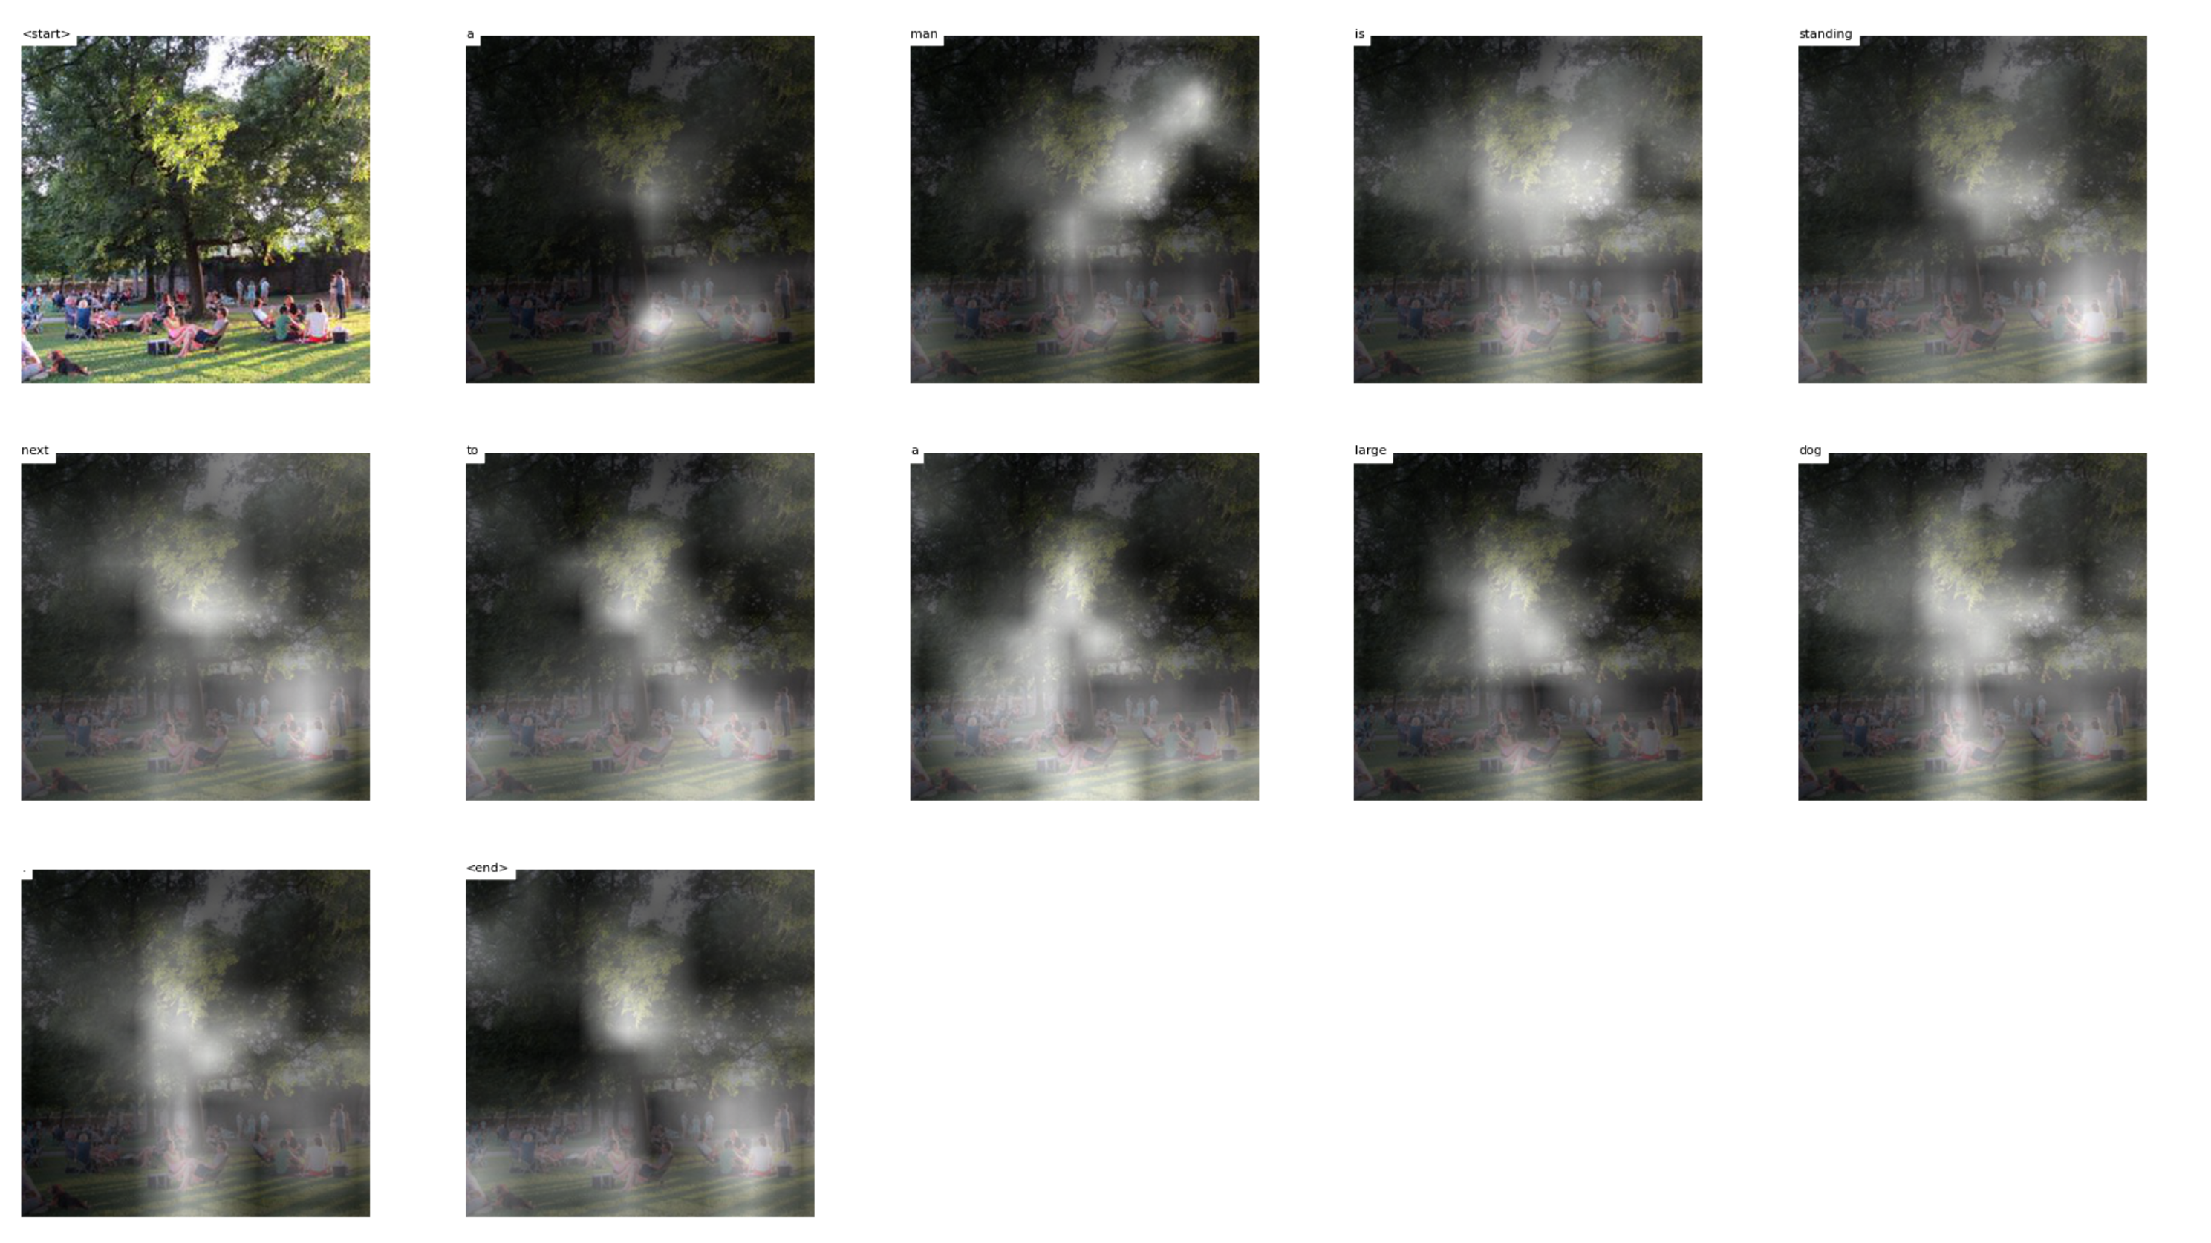
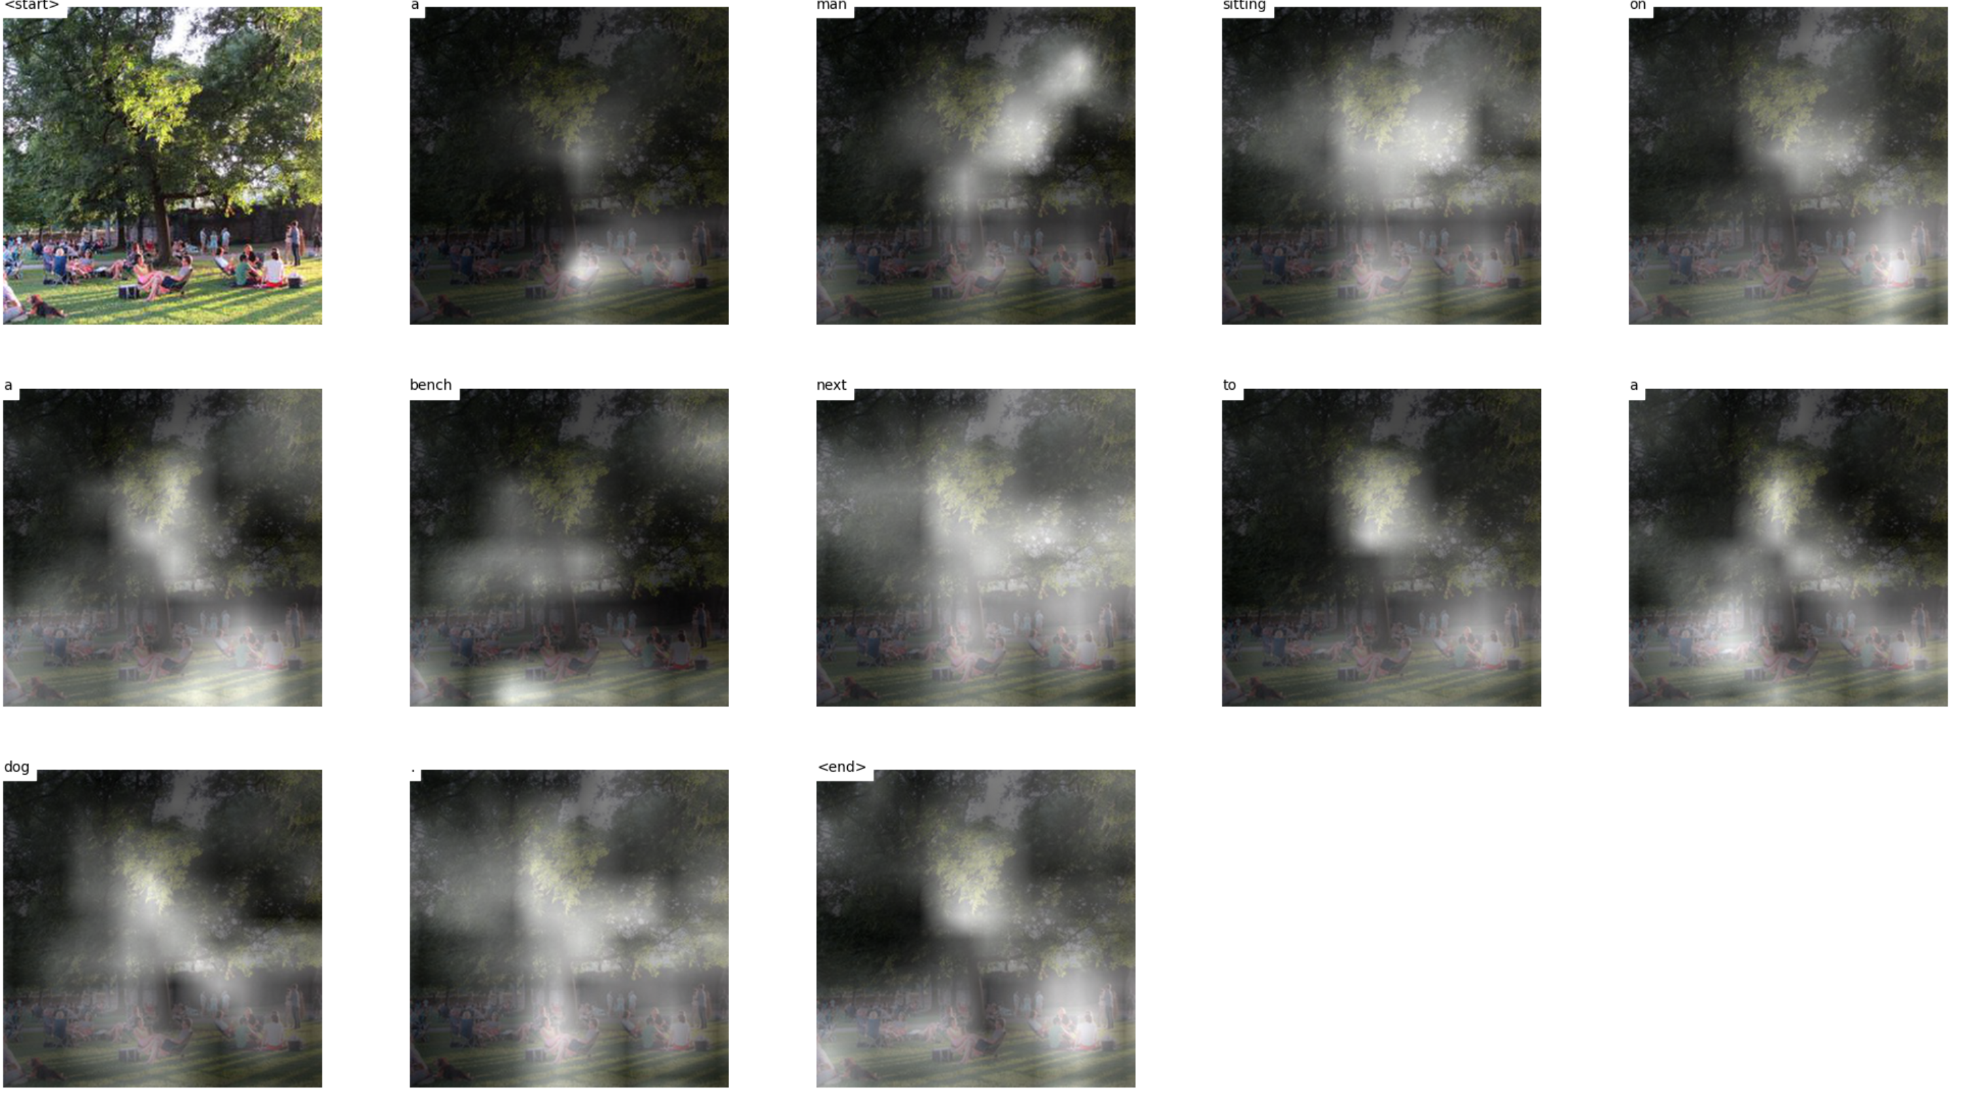
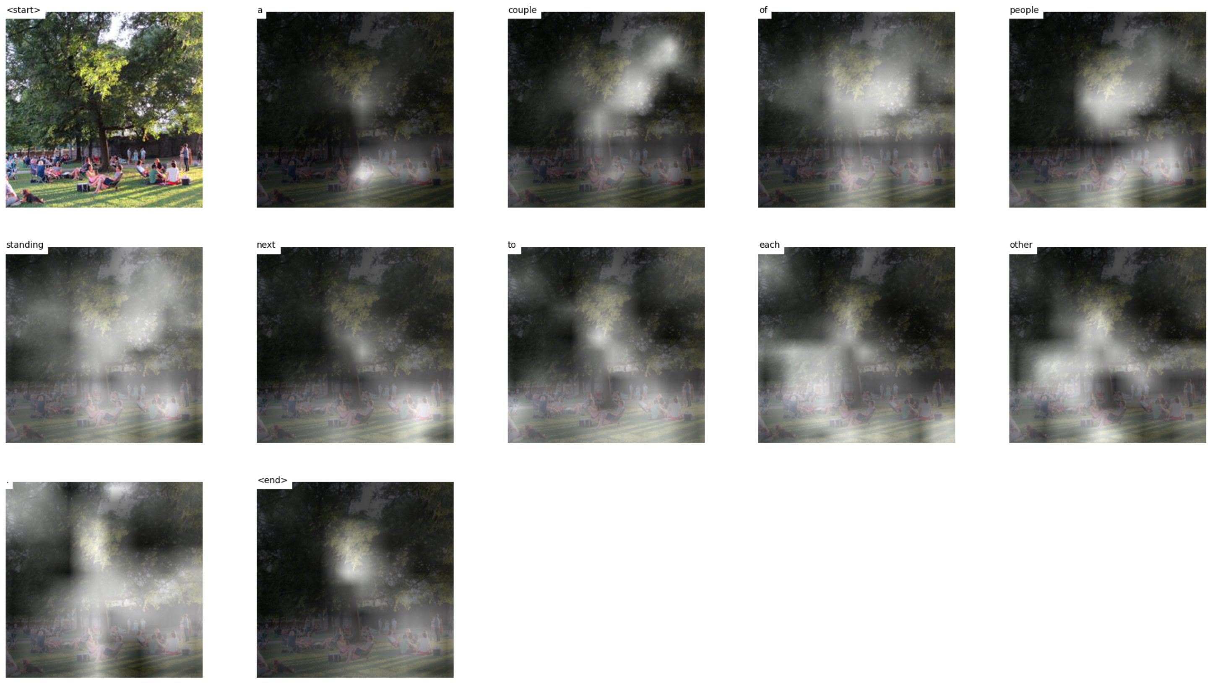
Test 10 images
Notes:
https://mobicon.tistory.com/537 -> 사진 참조
1) validate() 에서 val 데이터셋에서 prediction한 문장 hypothesis와 score 결과를 저장하고, 상위 10%, 하위10% 출력

Slide 7
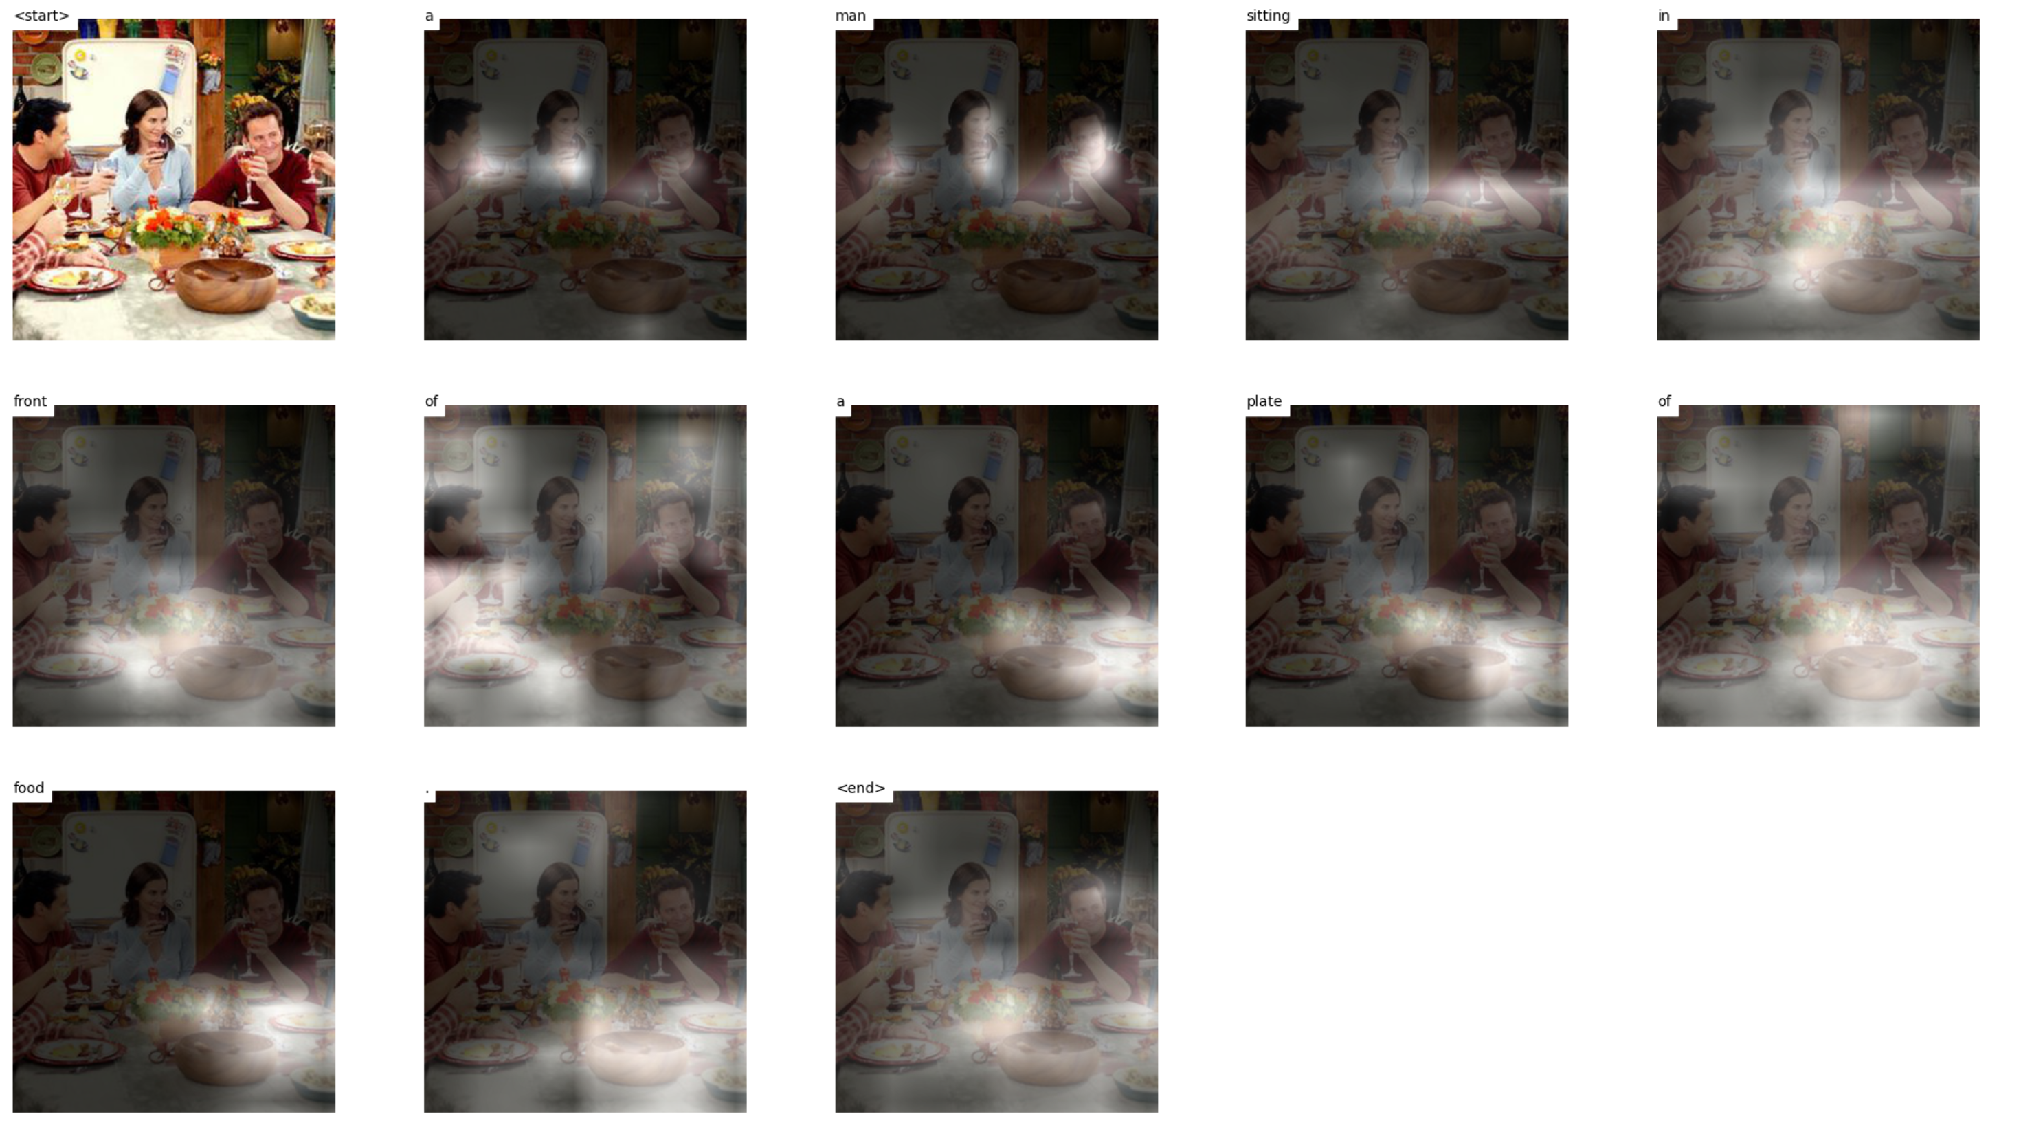
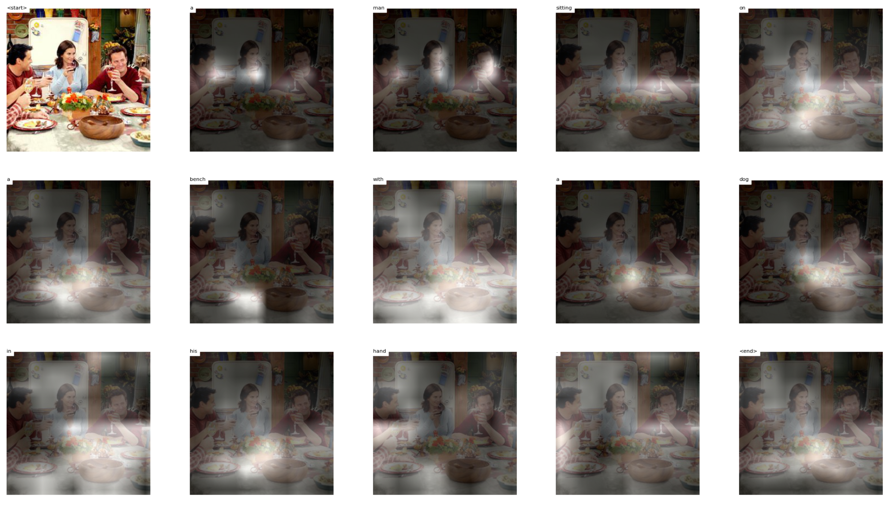
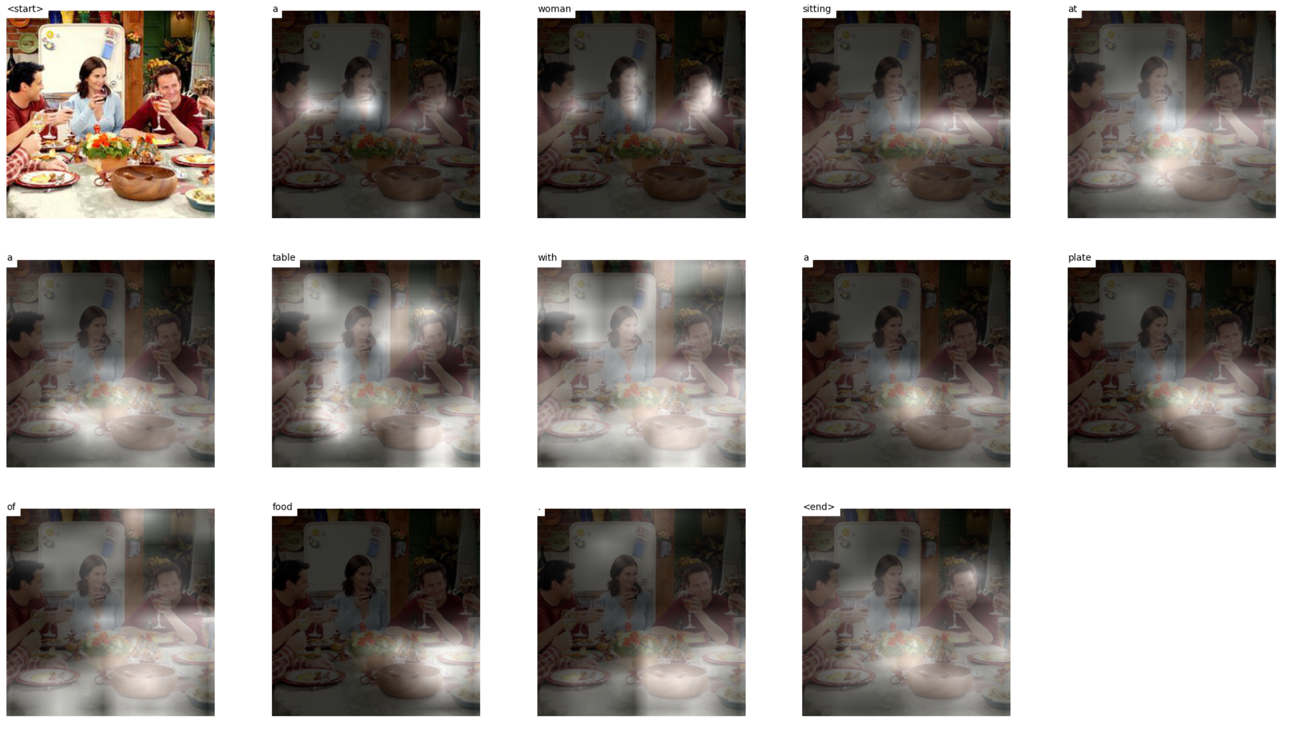
Test 10 images
Notes:
https://mobicon.tistory.com/537 -> 사진 참조
1) validate() 에서 val 데이터셋에서 prediction한 문장 hypothesis와 score 결과를 저장하고, 상위 10%, 하위10% 출력

Slide 8
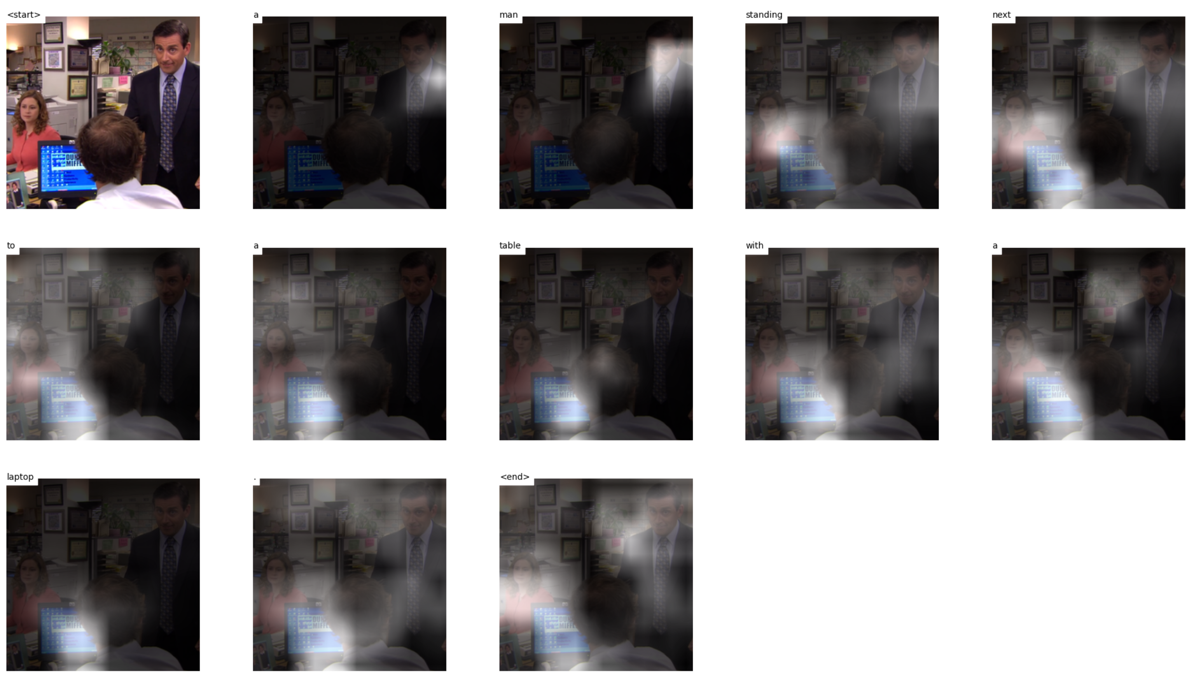
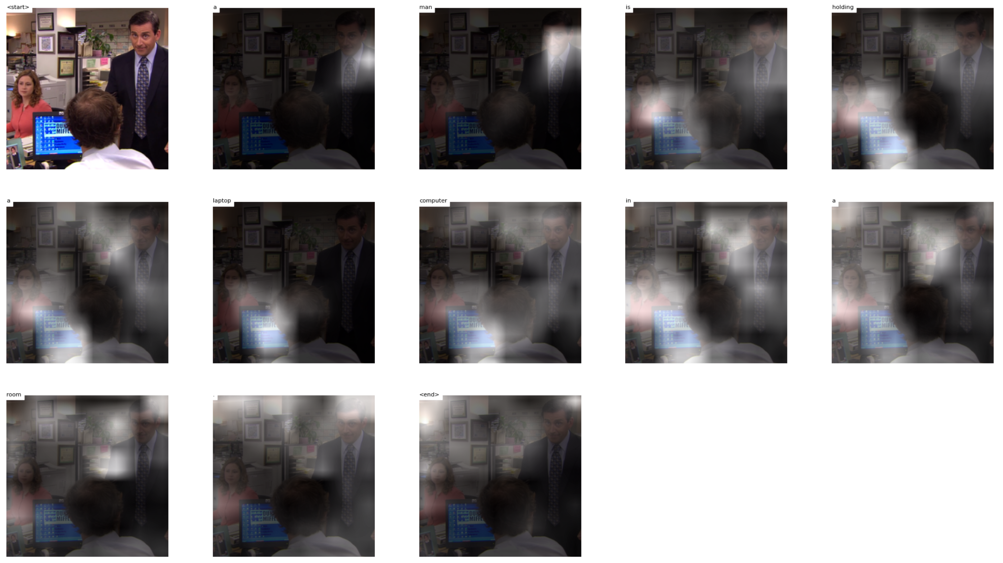
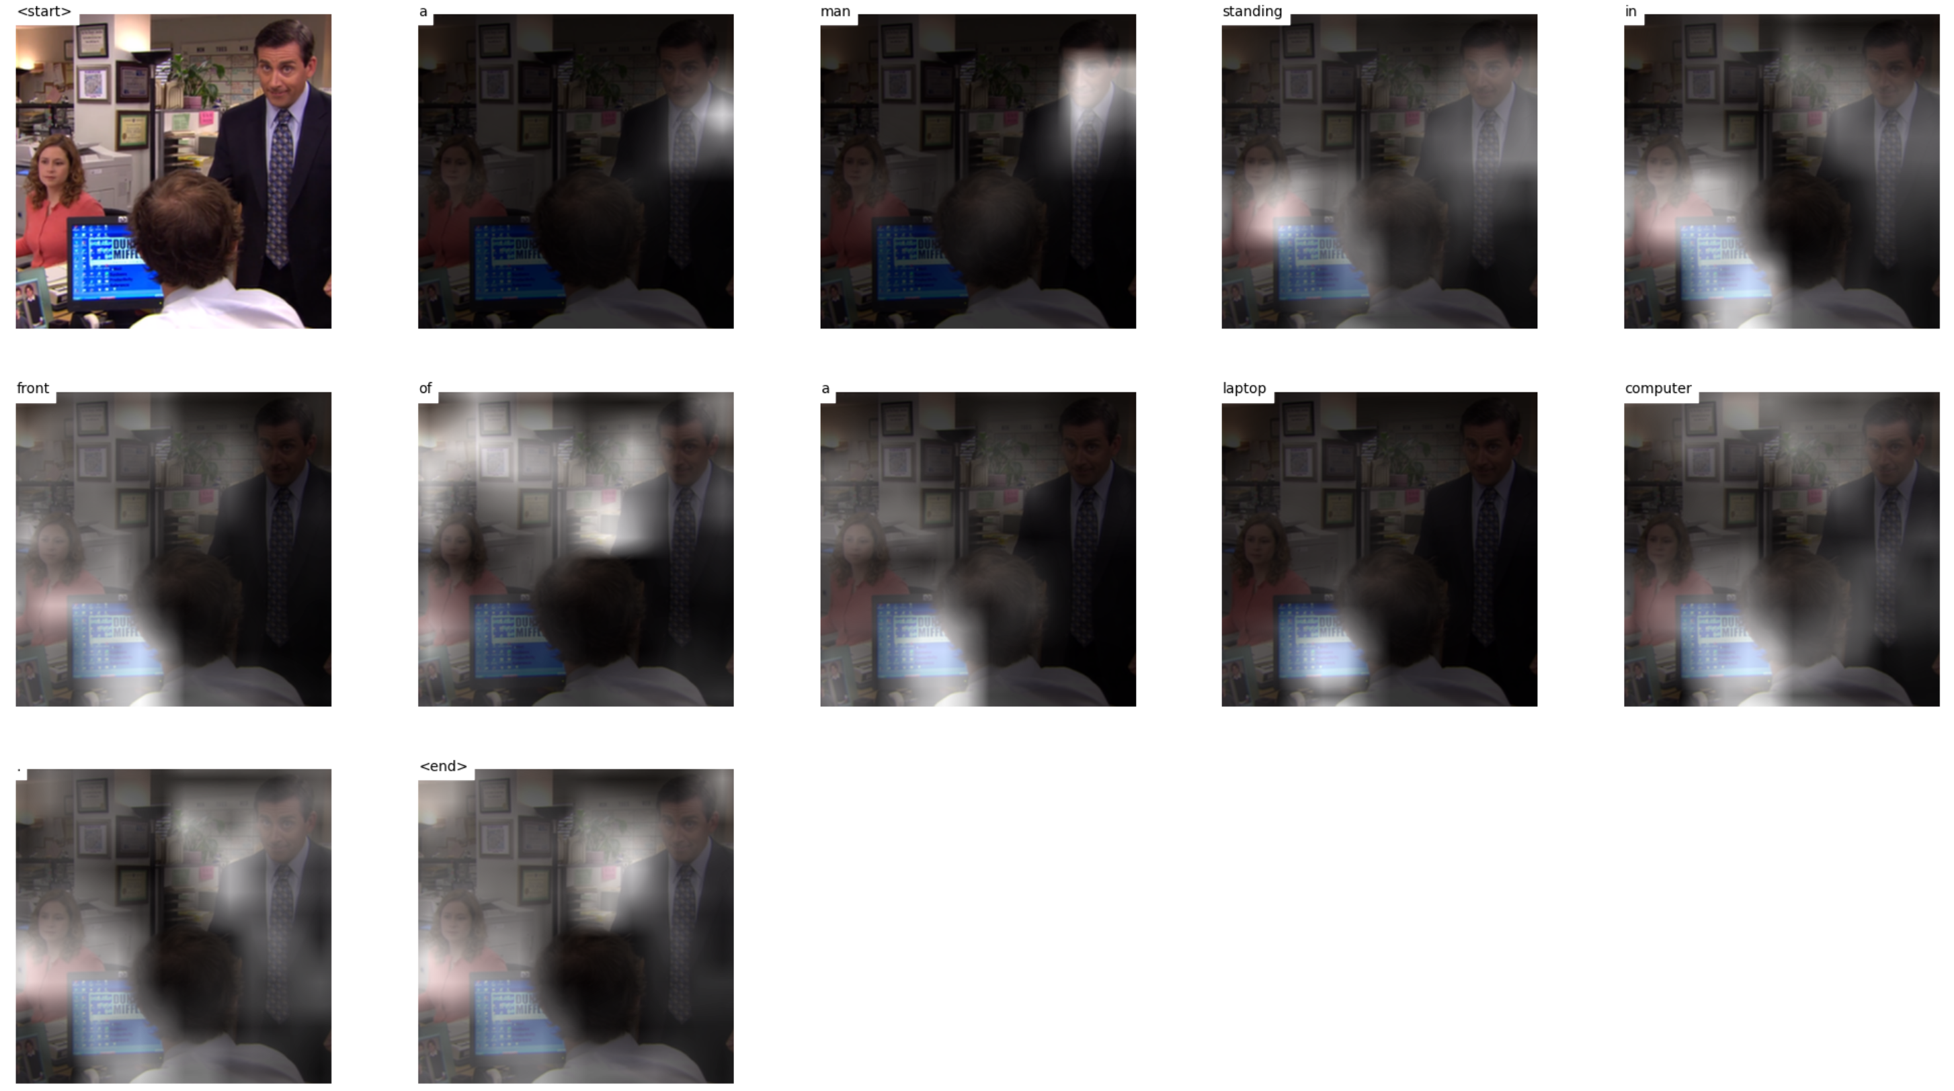
Test 10 images
Notes:
https://mobicon.tistory.com/537 -> 사진 참조
1) validate() 에서 val 데이터셋에서 prediction한 문장 hypothesis와 score 결과를 저장하고, 상위 10%, 하위10% 출력

Slide 9
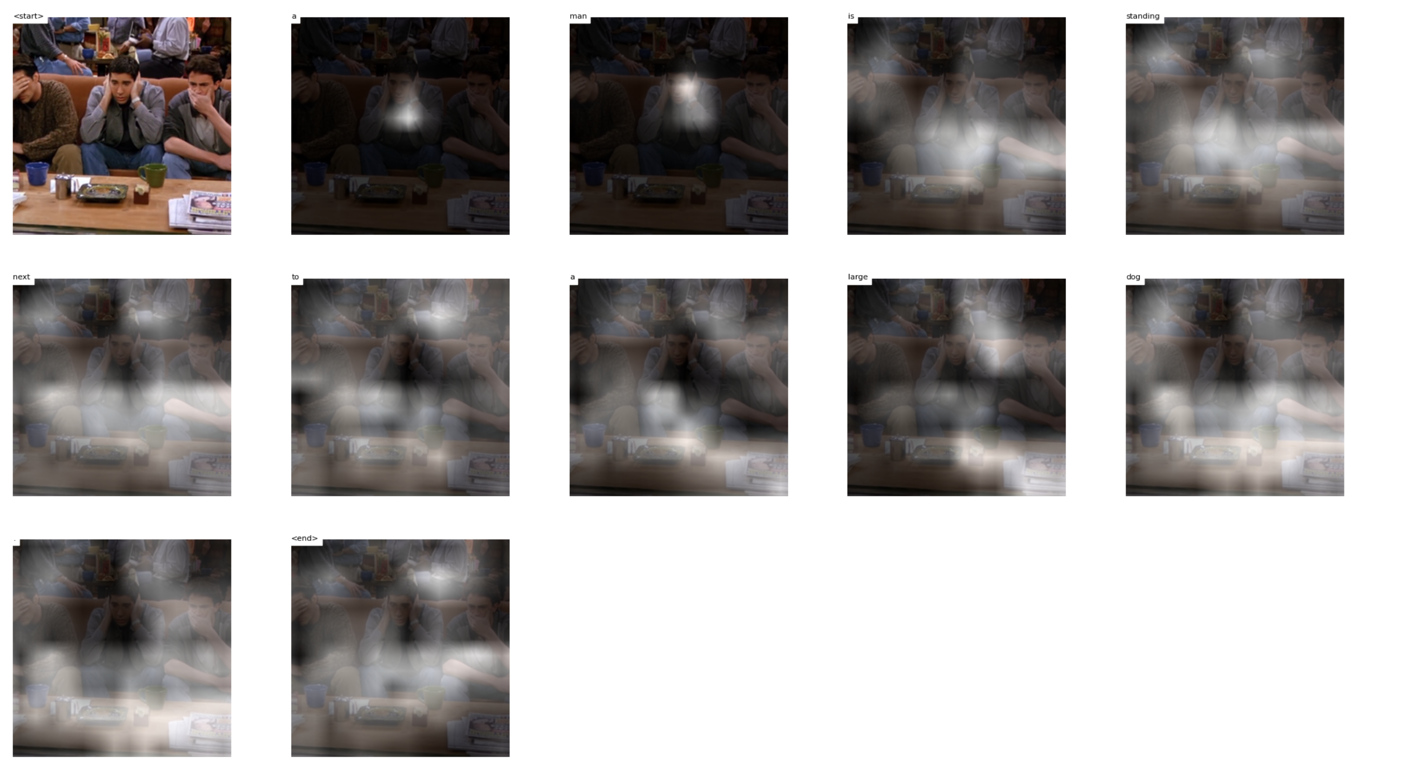
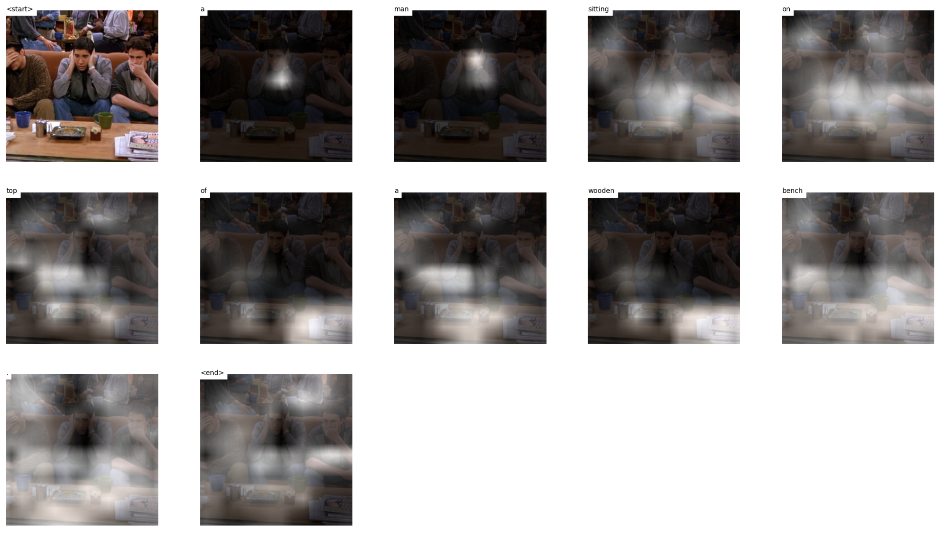
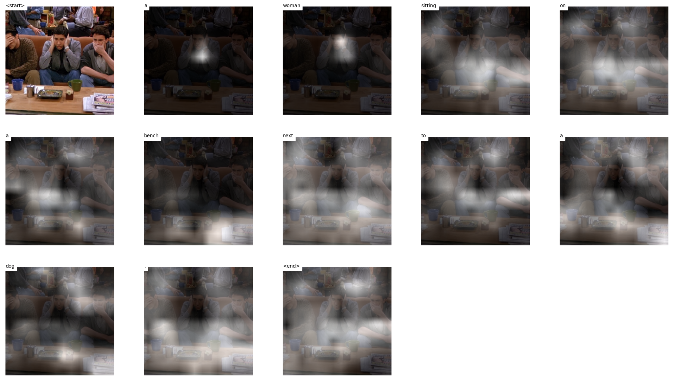
Test 10 images
Notes:
https://mobicon.tistory.com/537 -> 사진 참조
1) validate() 에서 val 데이터셋에서 prediction한 문장 hypothesis와 score 결과를 저장하고, 상위 10%, 하위10% 출력

Slide 10
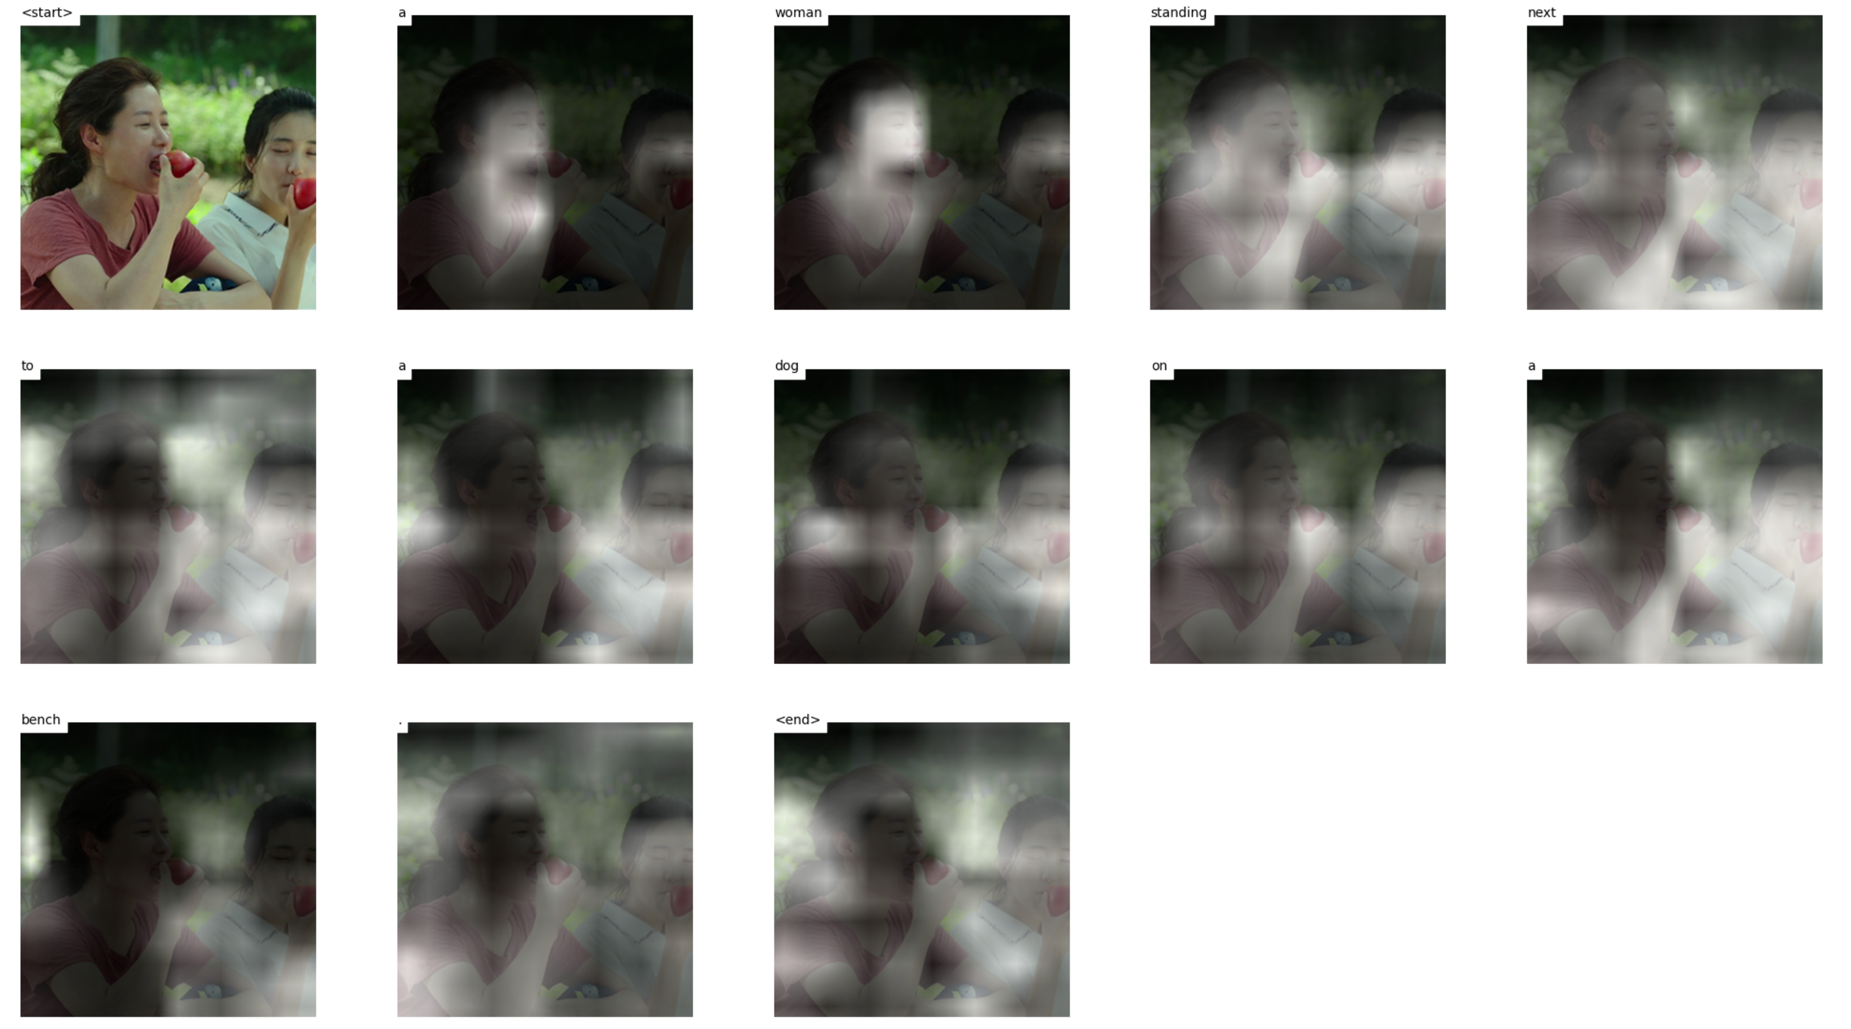
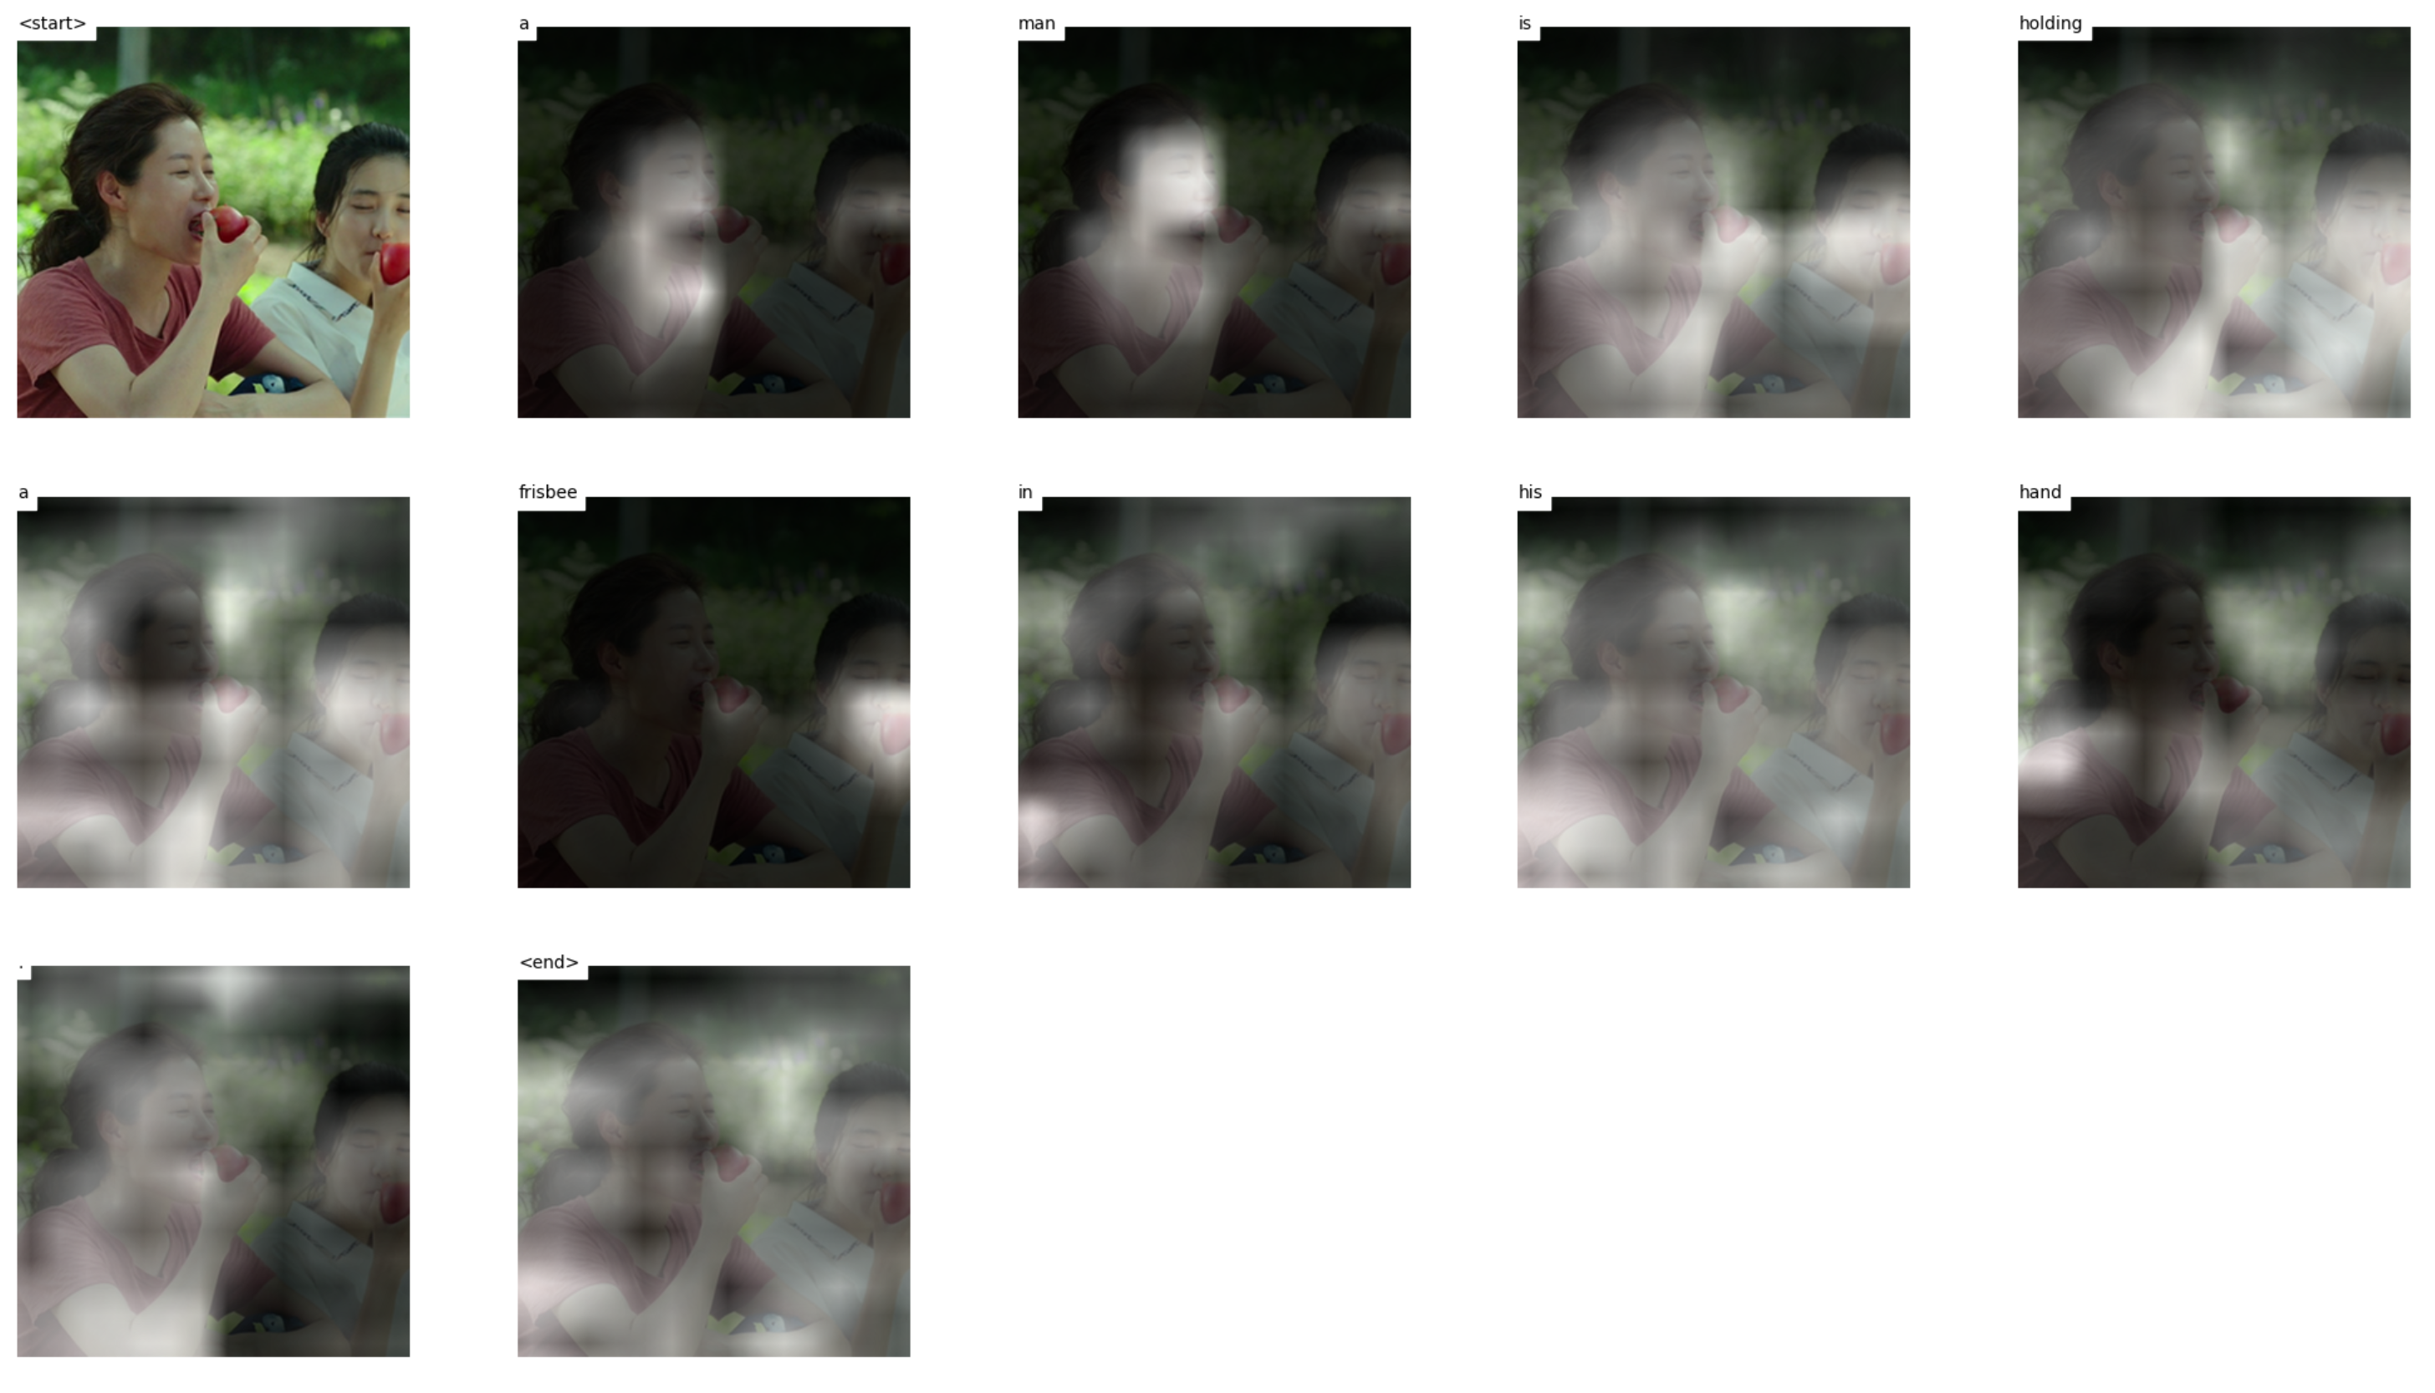
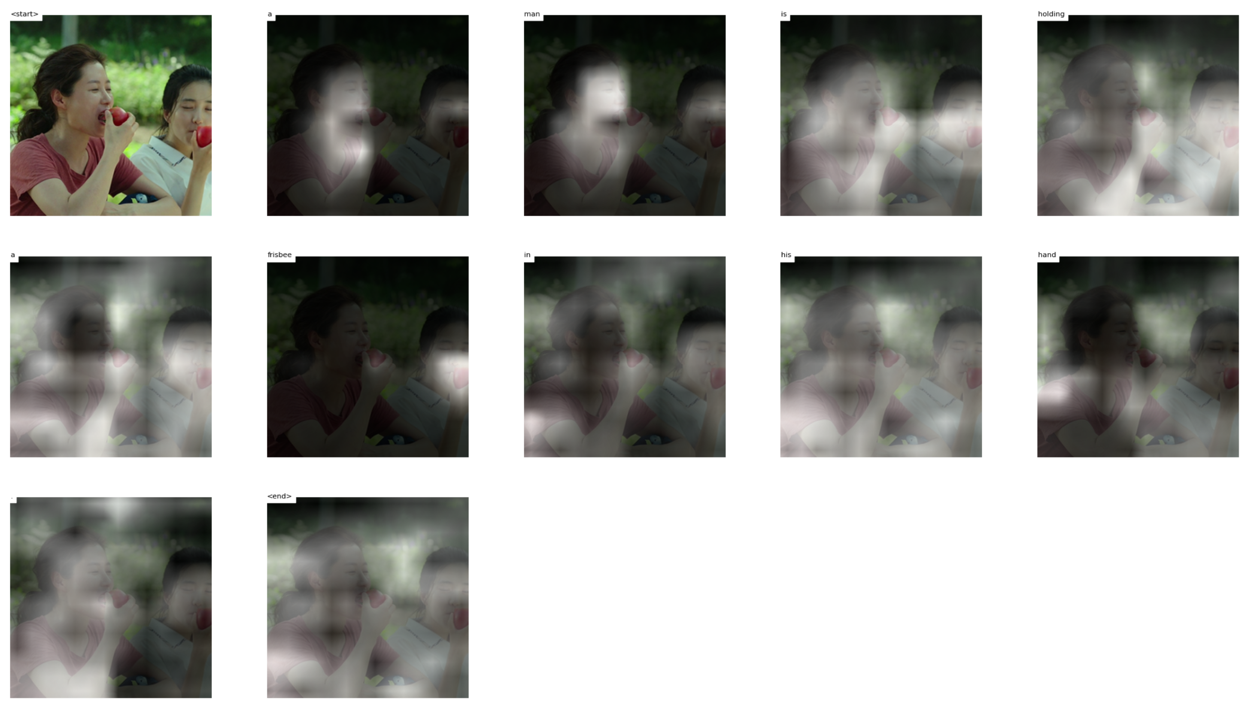
Test 10 images
Notes:
https://mobicon.tistory.com/537 -> 사진 참조
1) validate() 에서 val 데이터셋에서 prediction한 문장 hypothesis와 score 결과를 저장하고, 상위 10%, 하위10% 출력

Slide 11
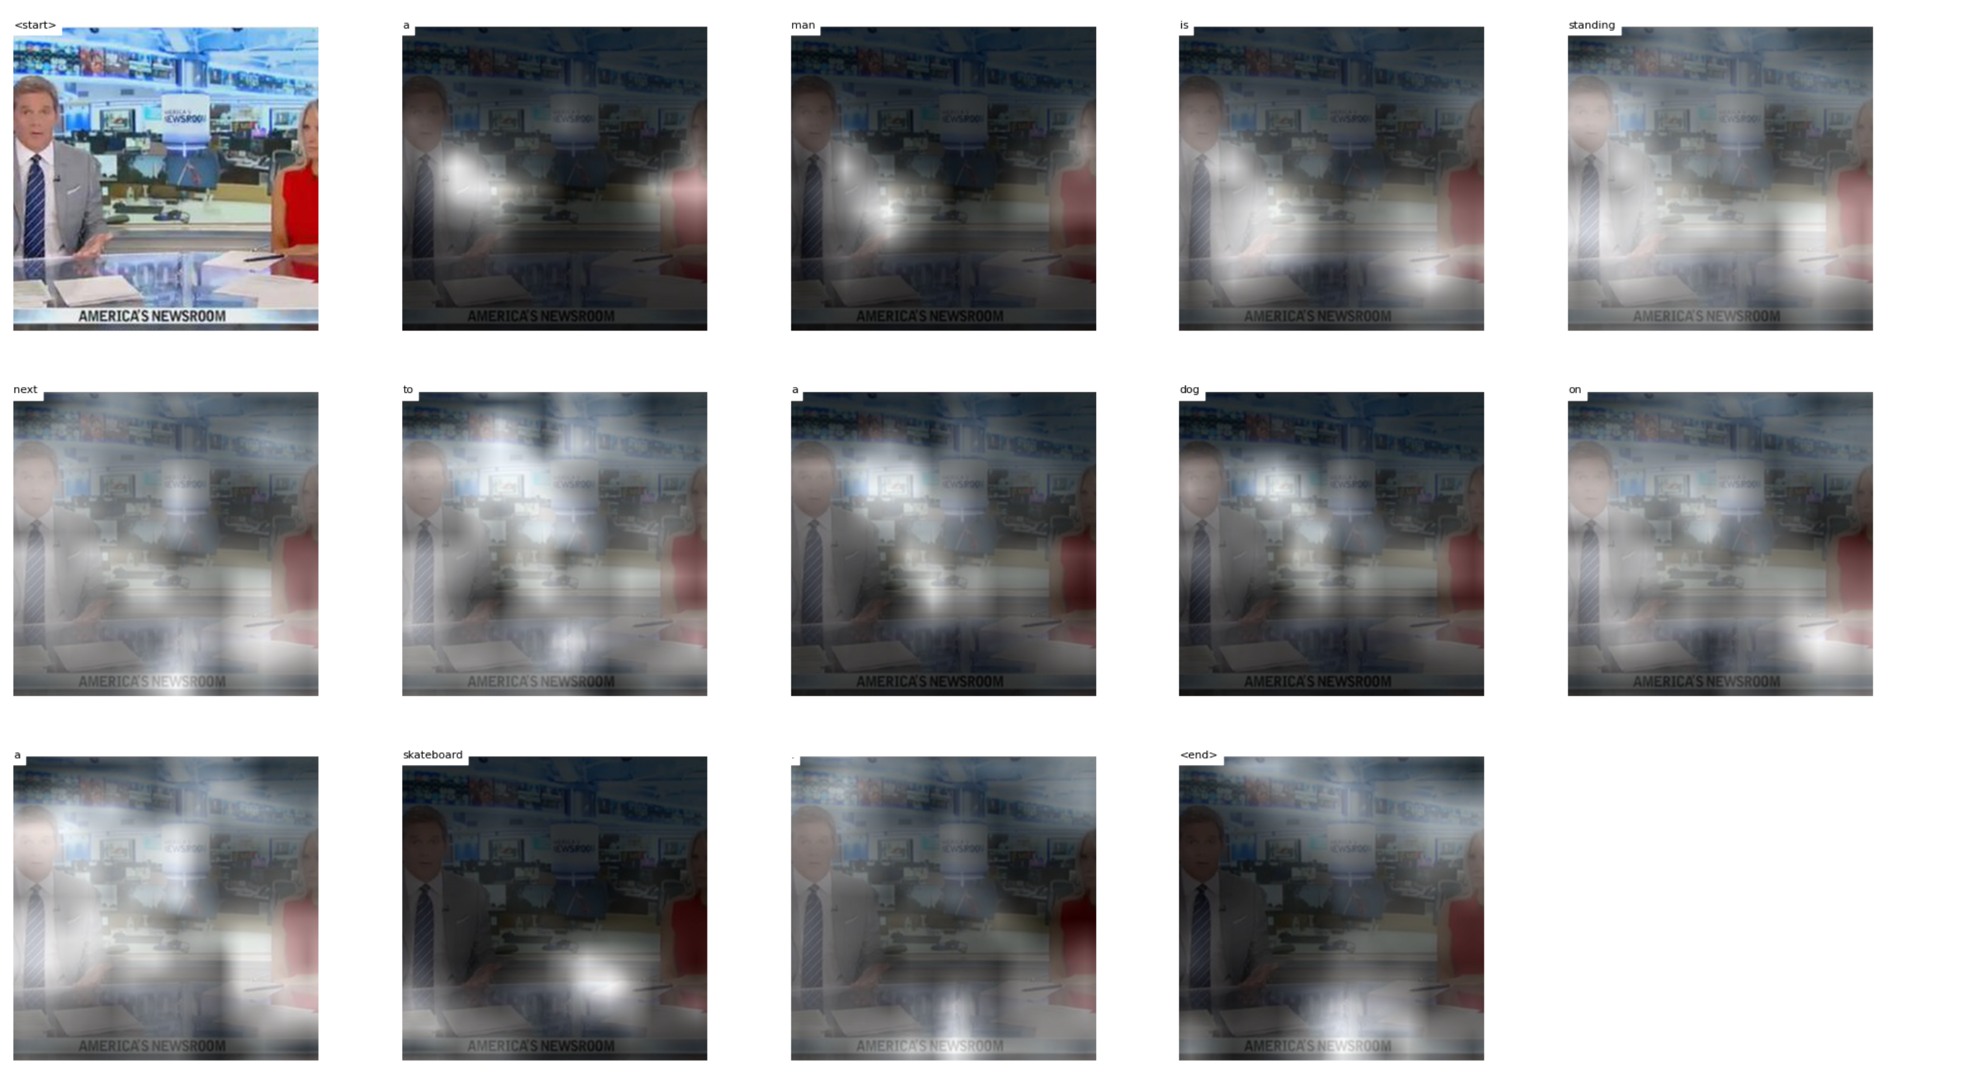
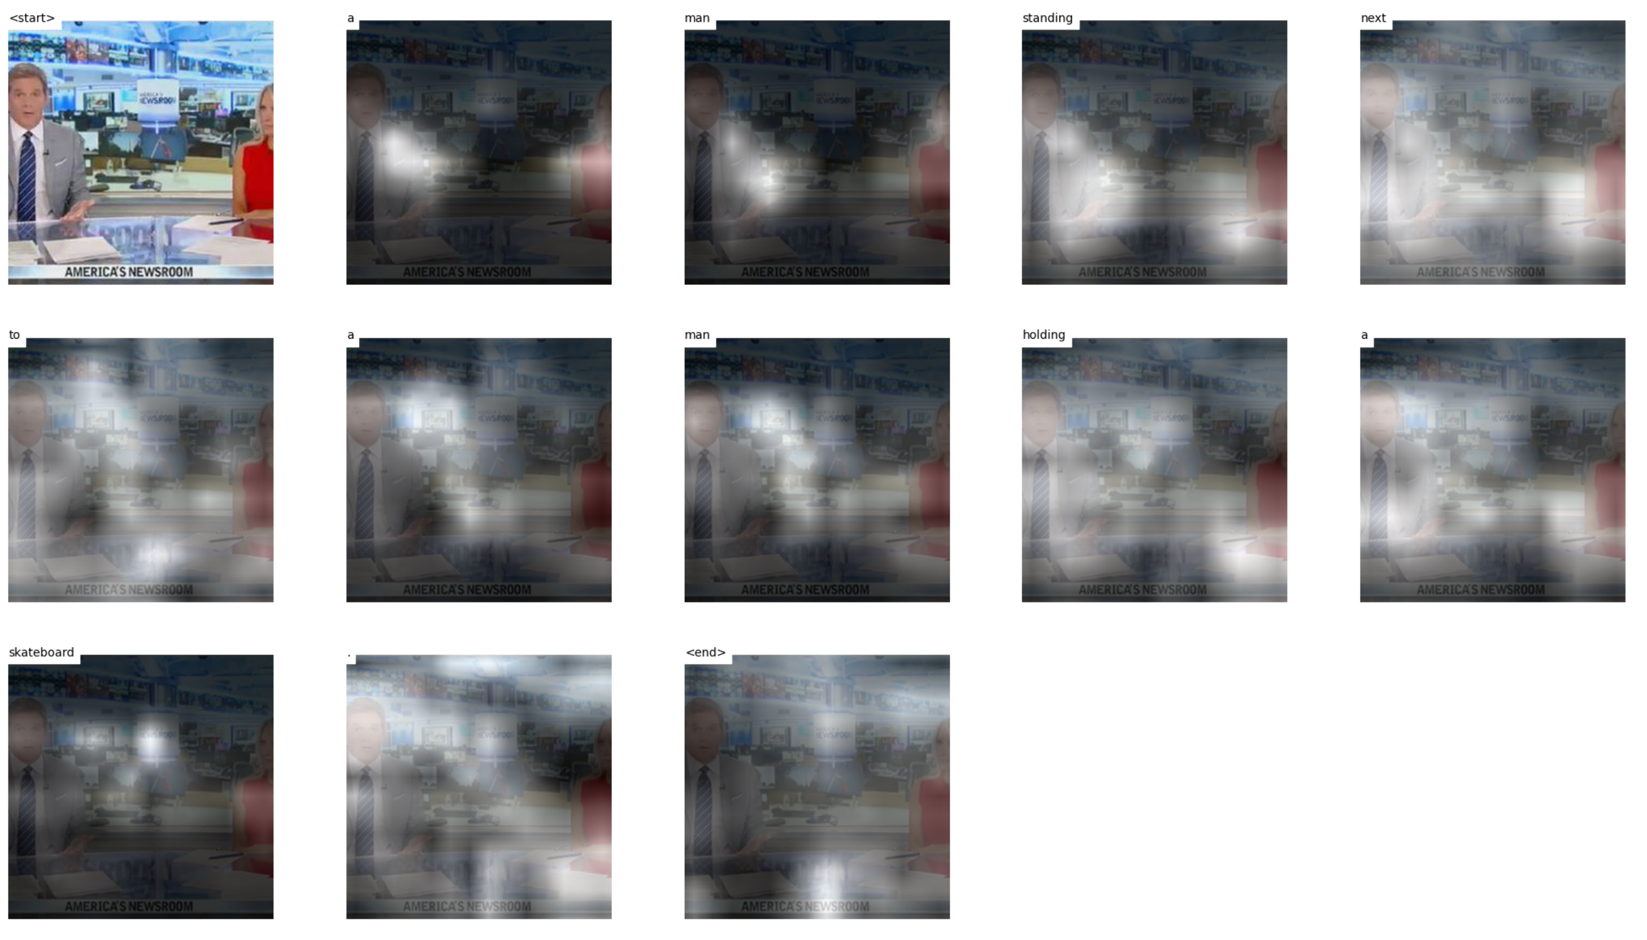
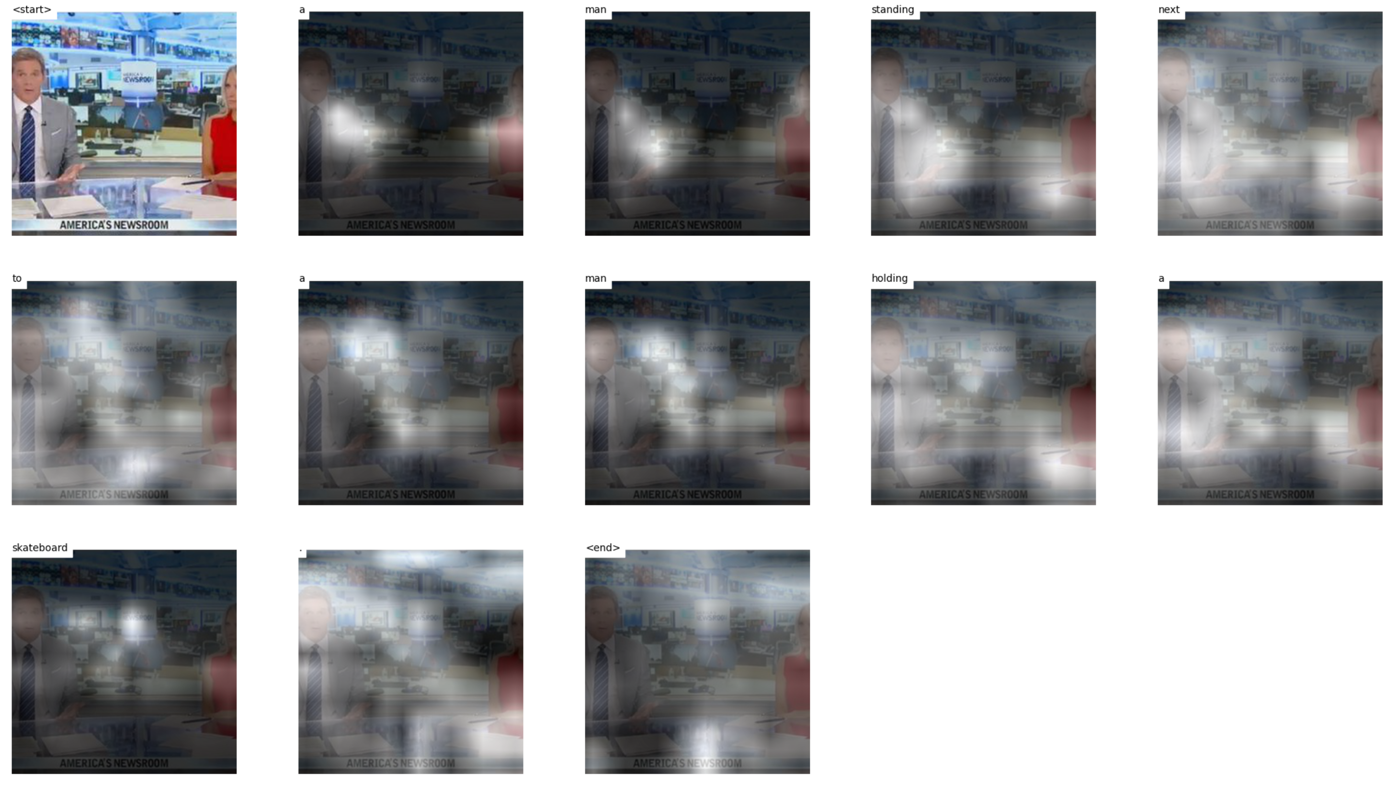
Test 10 images
Notes:
https://mobicon.tistory.com/537 -> 사진 참조
1) validate() 에서 val 데이터셋에서 prediction한 문장 hypothesis와 score 결과를 저장하고, 상위 10%, 하위10% 출력

Slide 12
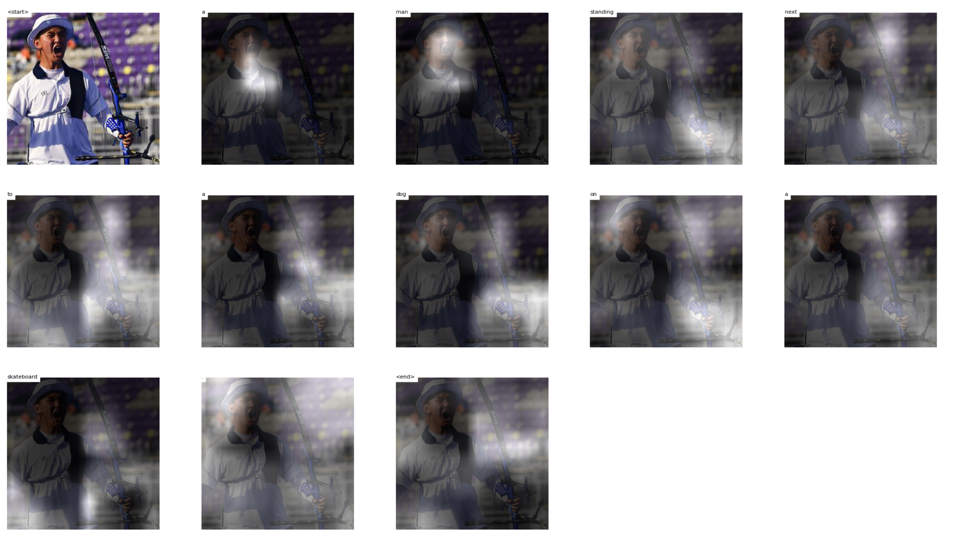
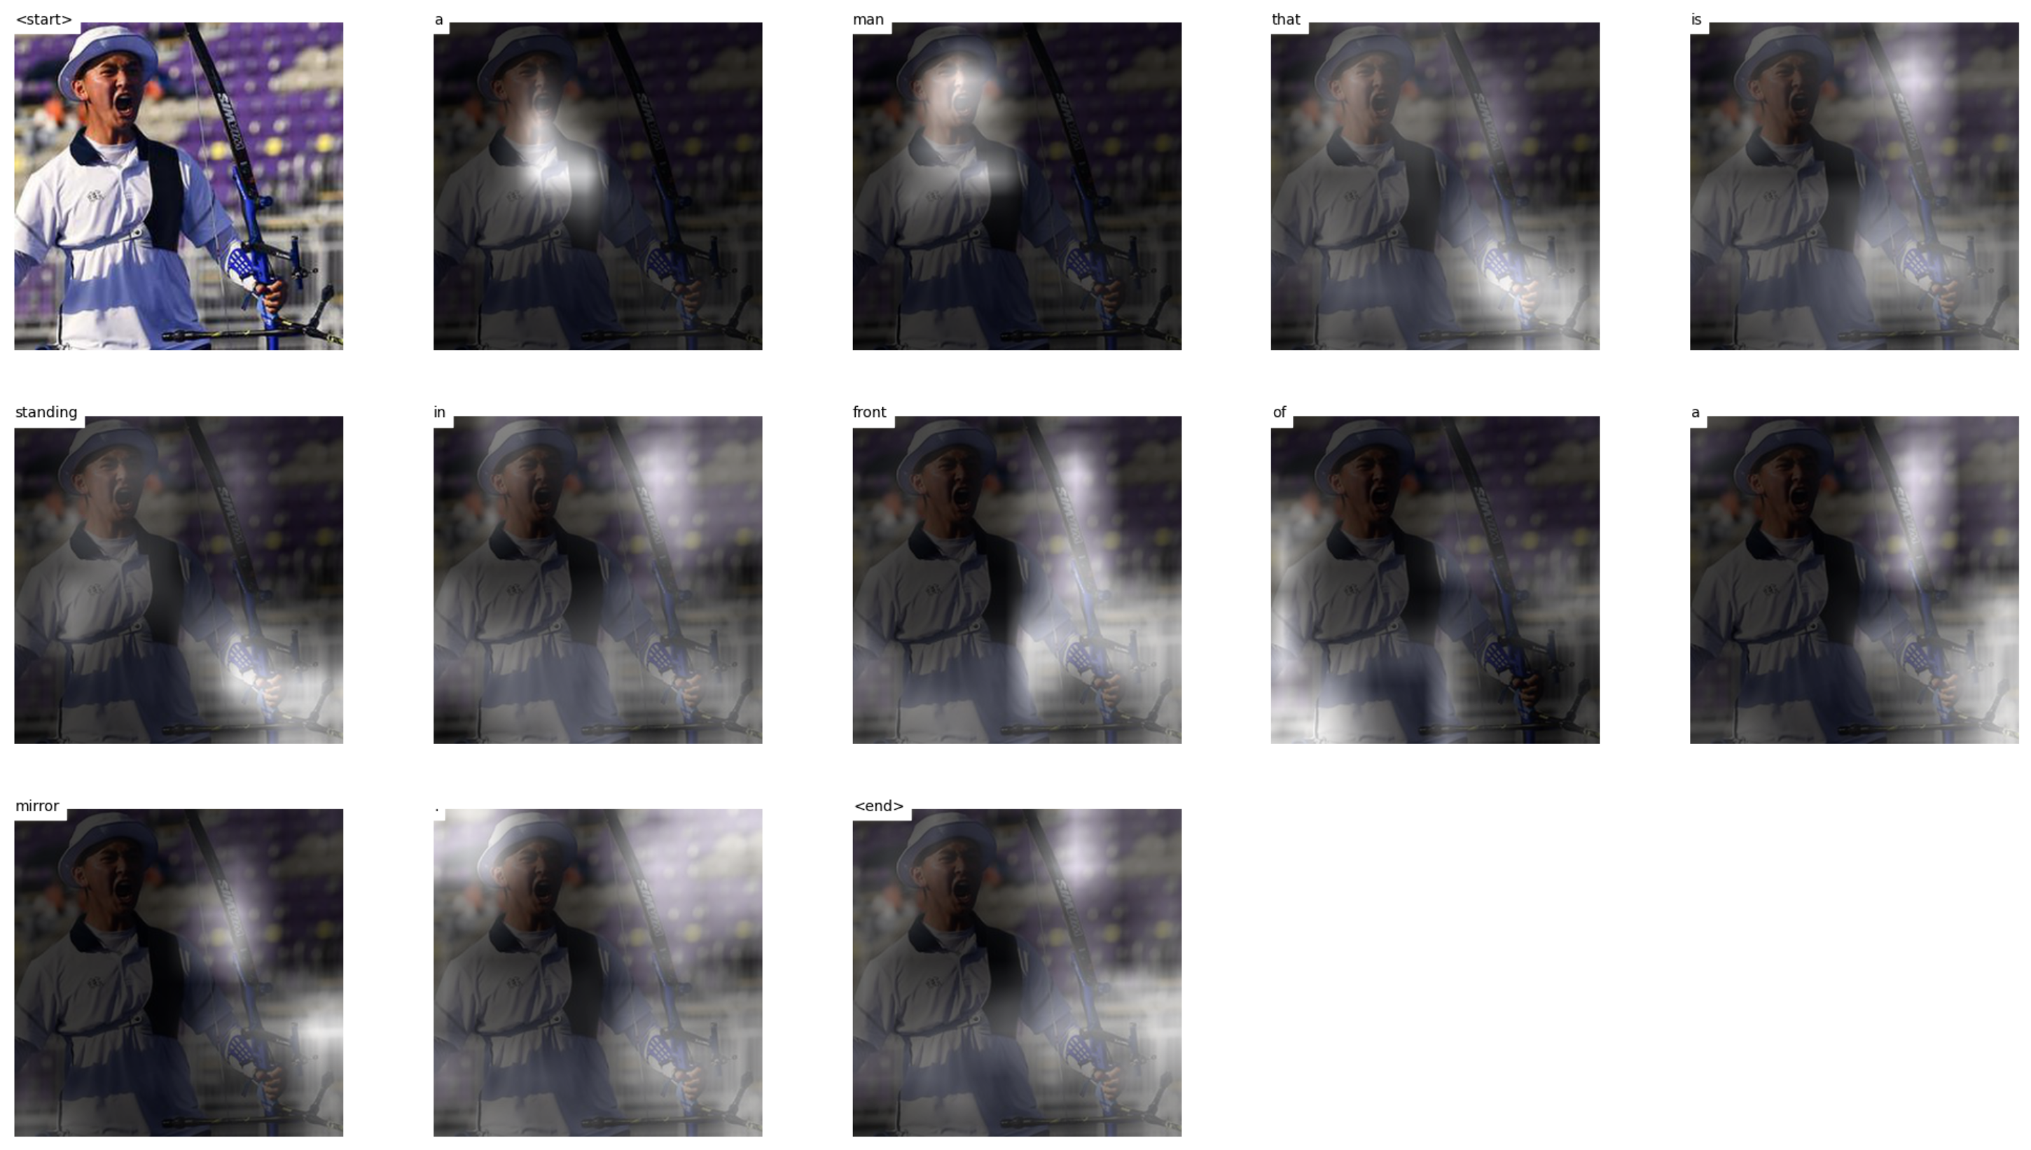
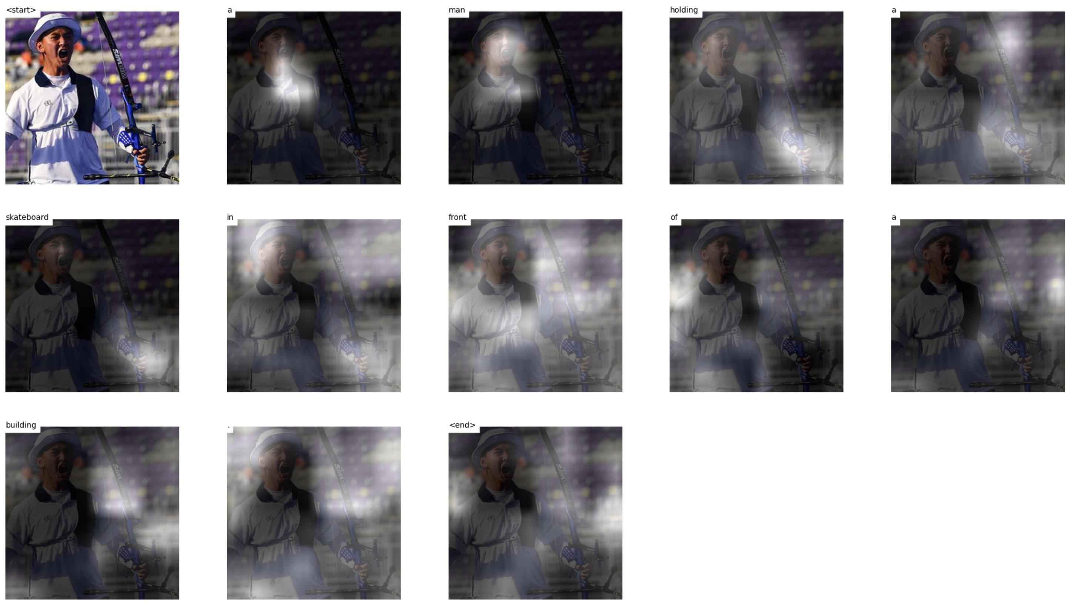
Test 10 images
Notes:
https://mobicon.tistory.com/537 -> 사진 참조
1) validate() 에서 val 데이터셋에서 prediction한 문장 hypothesis와 score 결과를 저장하고, 상위 10%, 하위10% 출력

Slide 13
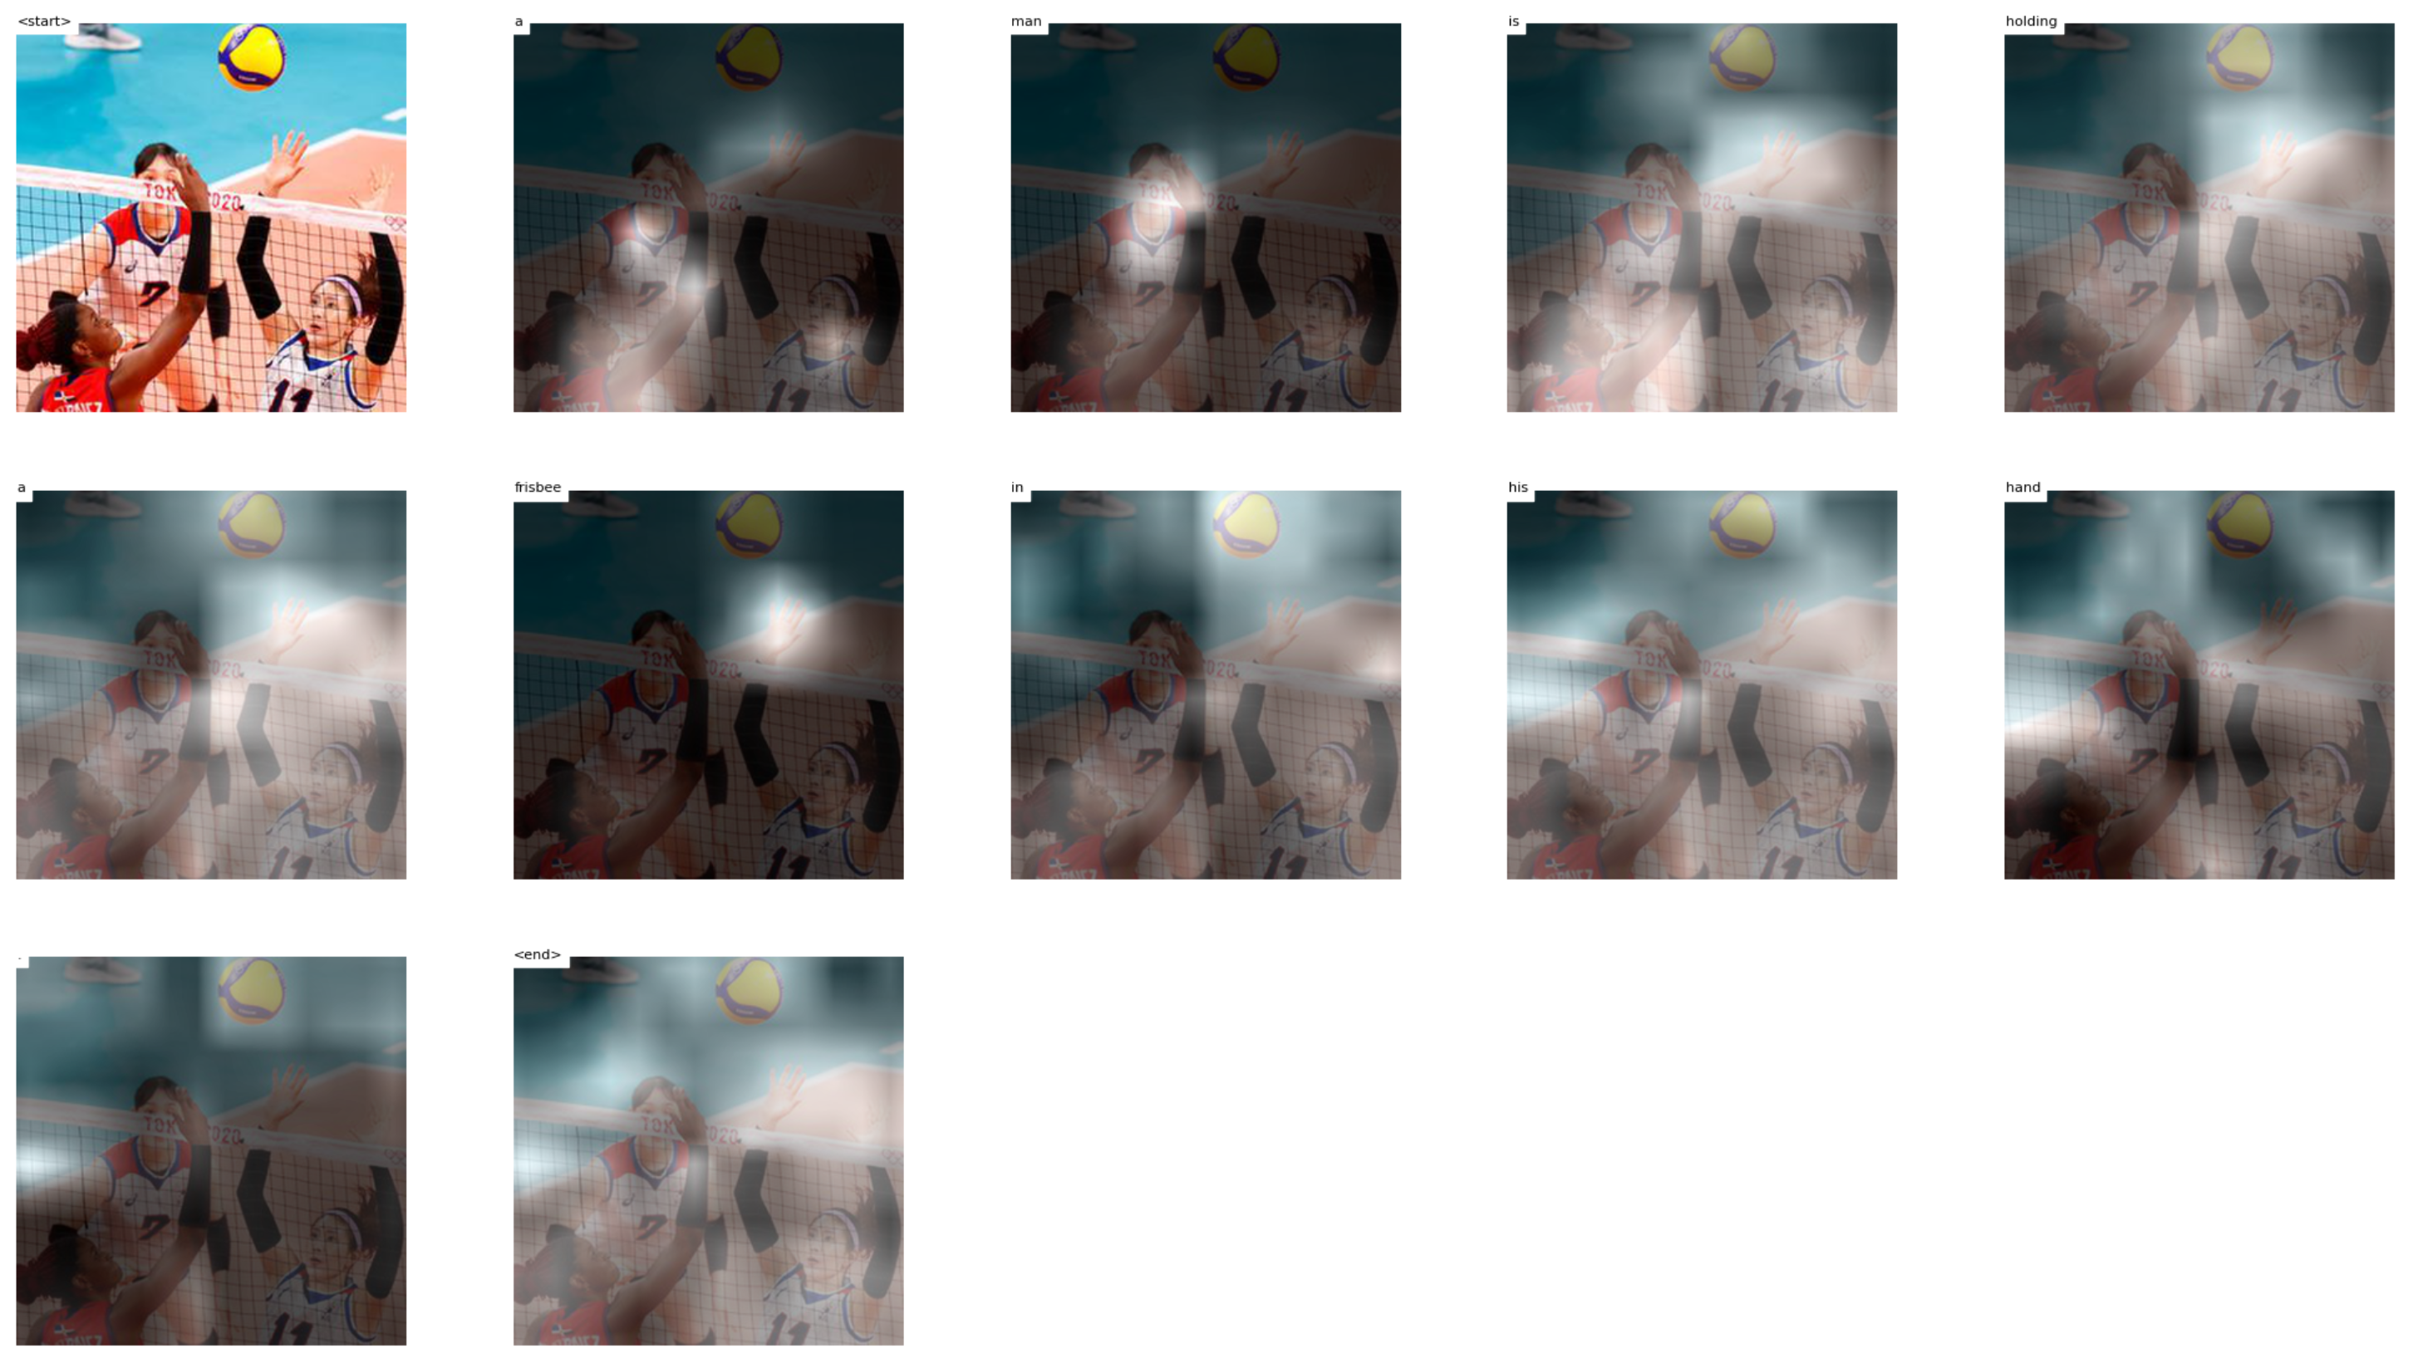
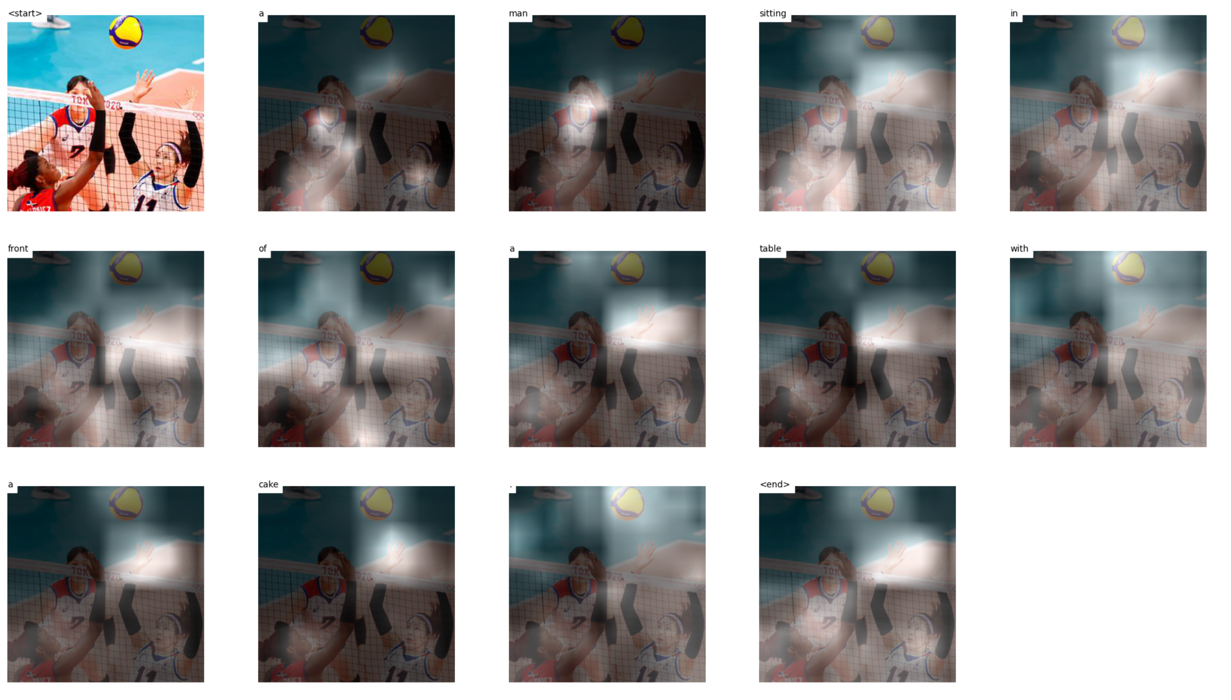
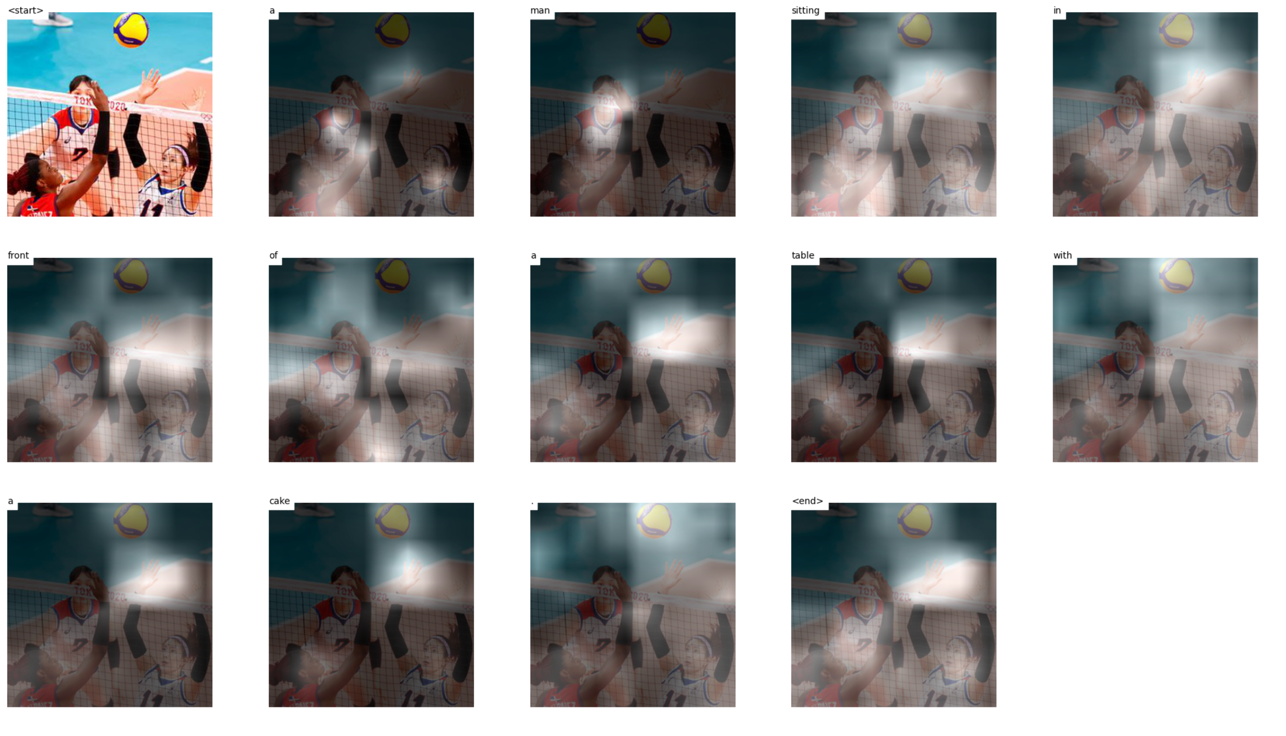
Test 10 images
Notes:
https://mobicon.tistory.com/537 -> 사진 참조
1) validate() 에서 val 데이터셋에서 prediction한 문장 hypothesis와 score 결과를 저장하고, 상위 10%, 하위10% 출력

Slide 14
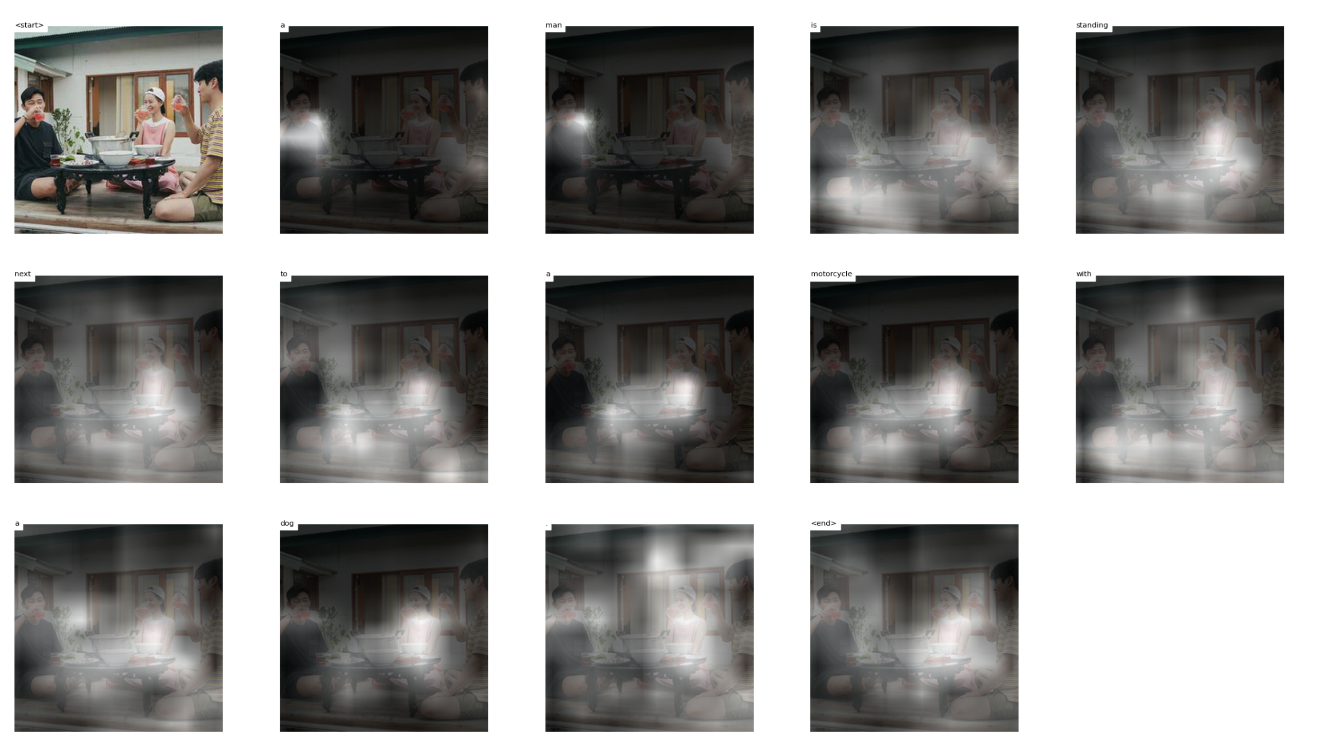
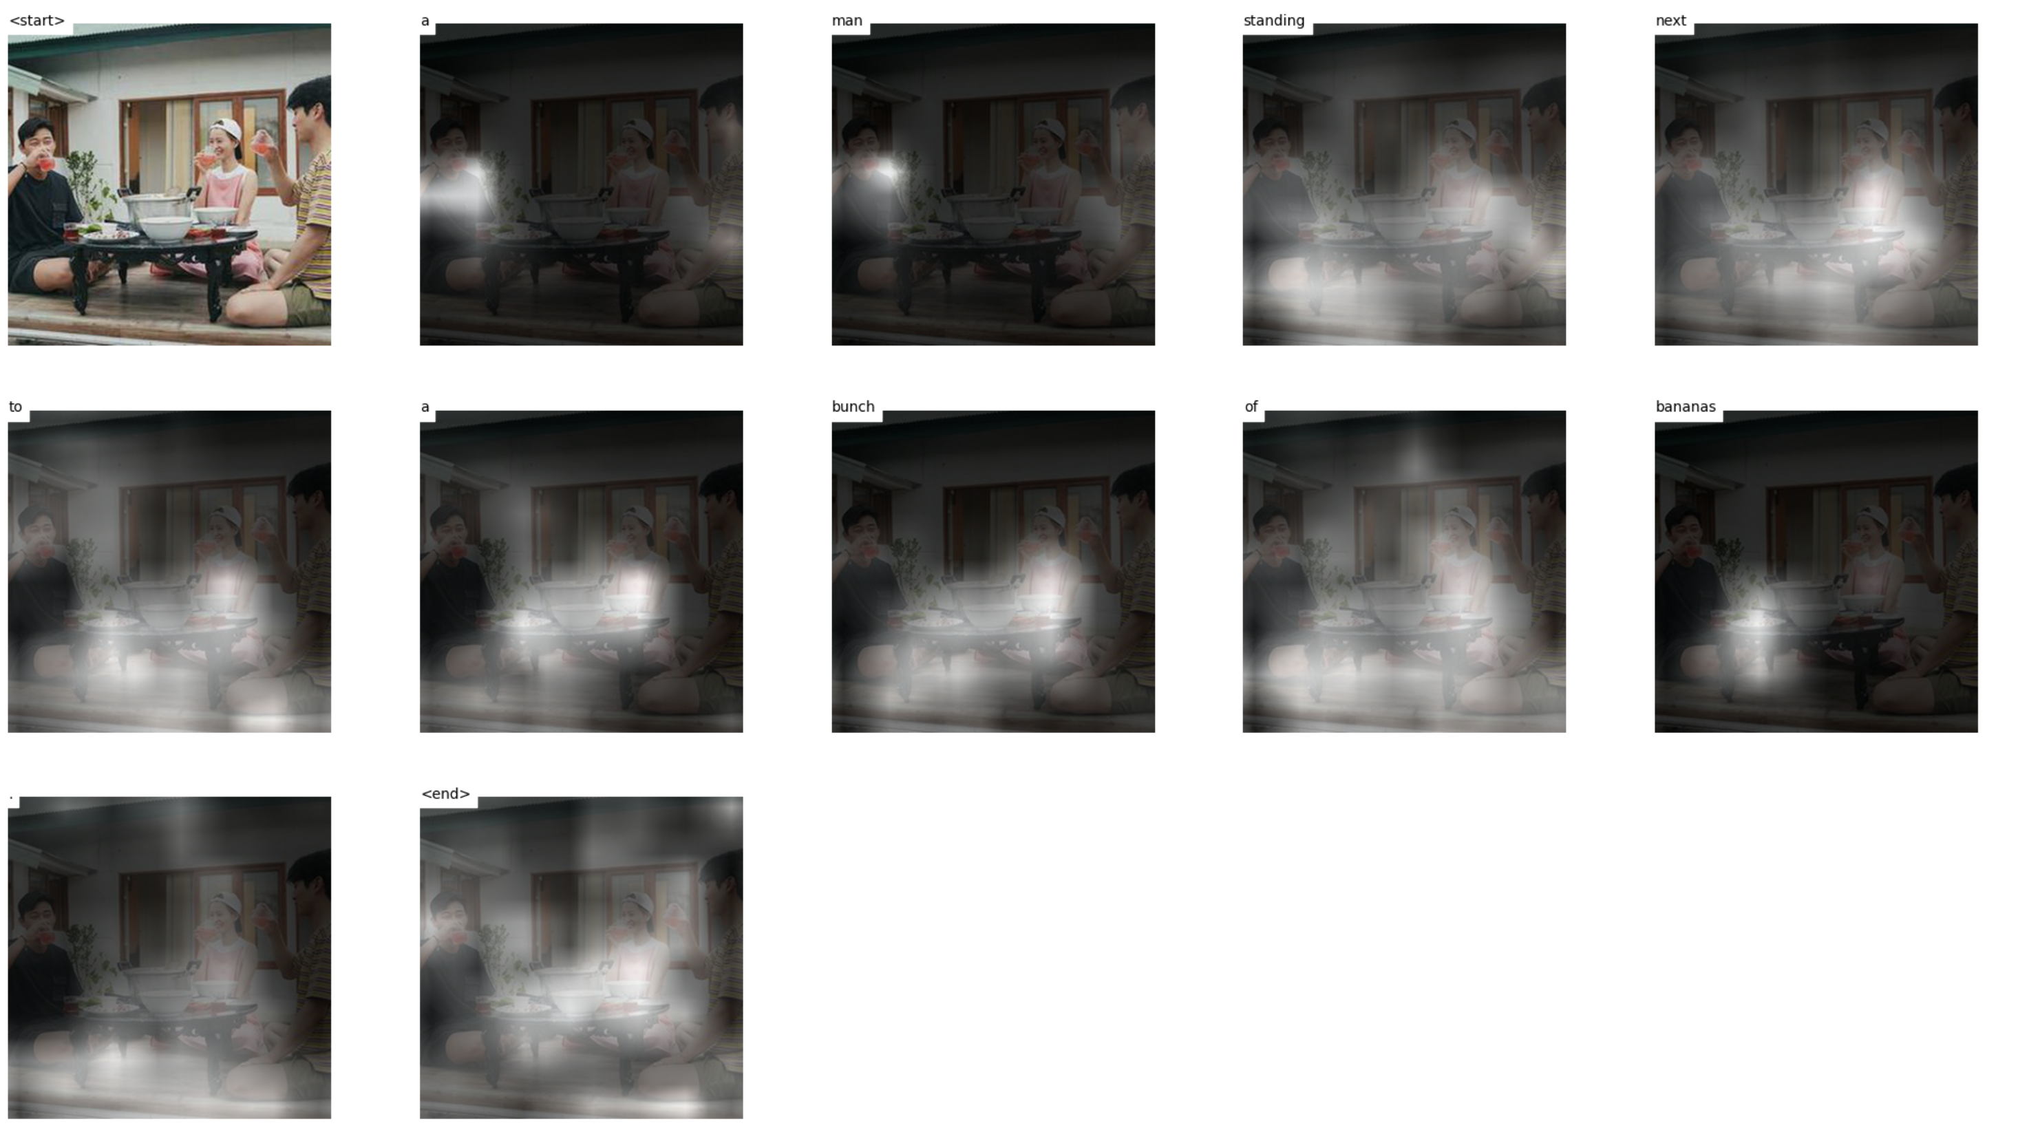
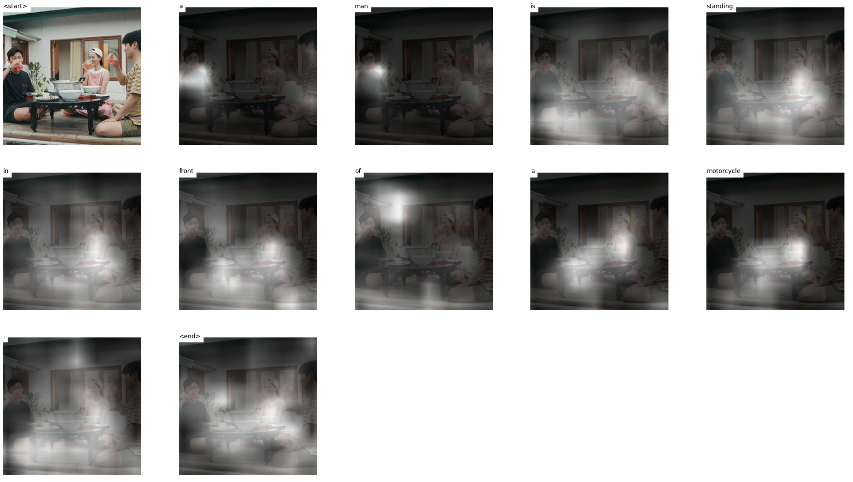
Test 10 images beam size 1,5,10
Notes:
https://mobicon.tistory.com/537 -> 사진 참조
1) validate() 에서 val 데이터셋에서 prediction한 문장 hypothesis와 score 결과를 저장하고, 상위 10%, 하위10% 출력

Slide 15
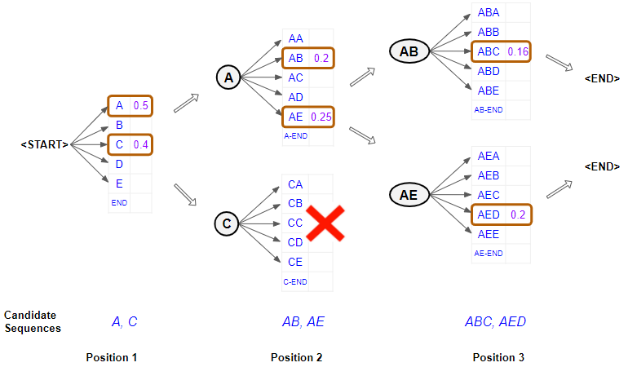
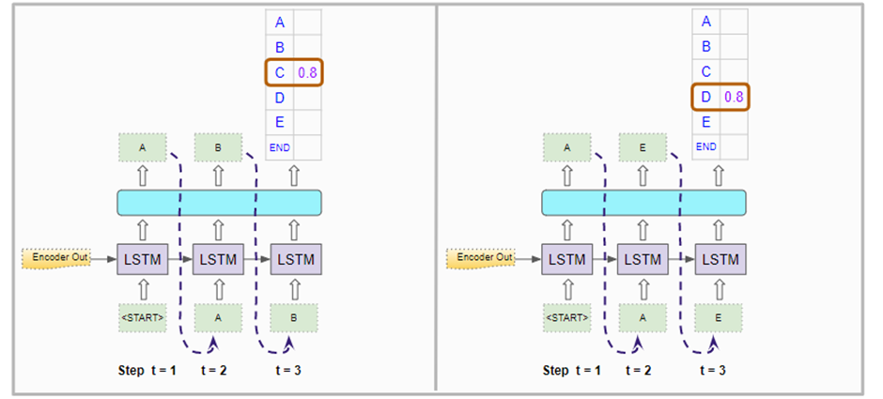
Beam Search
현재 time step에서 top k를 선택해서 다음 time step에서 k번 inference를 수행한다.
총 k*|v| 개의 softmax 결과 값 중에서 다시 top k개 선택한다.
Notes:
https://mobicon.tistory.com/537 -> 사진 참조
1) validate() 에서 val 데이터셋에서 prediction한 문장 hypothesis와 score 결과를 저장하고, 상위 10%, 하위10% 출력

Slide 16
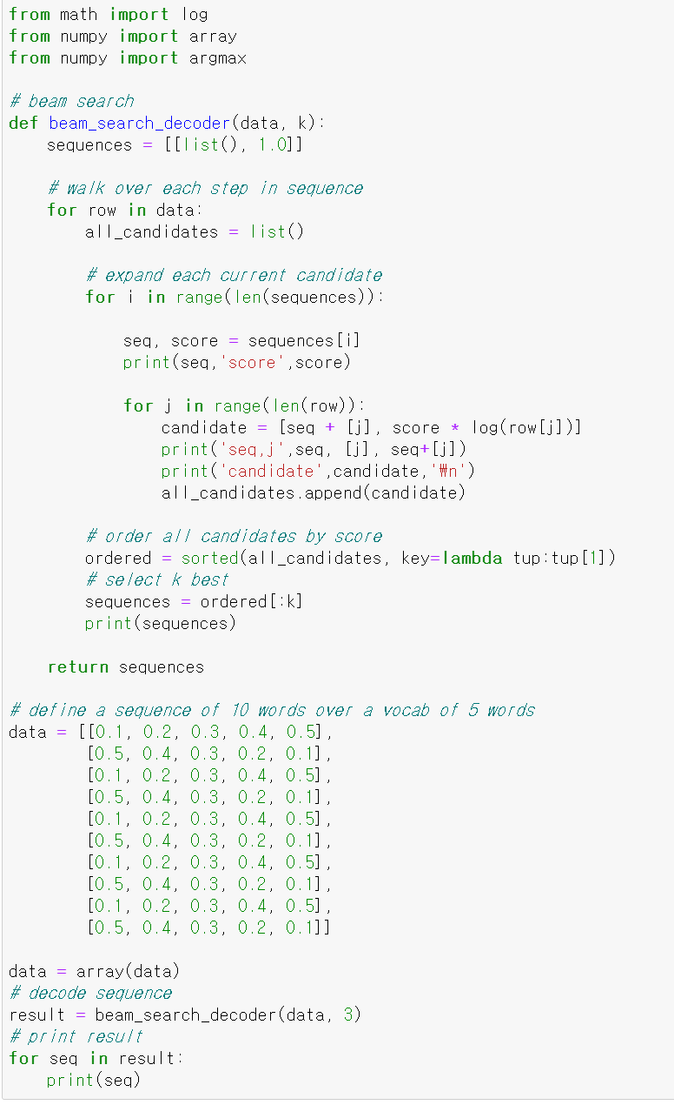
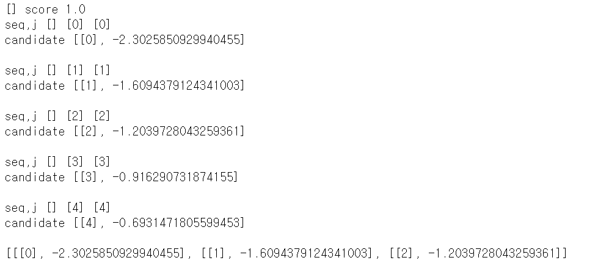
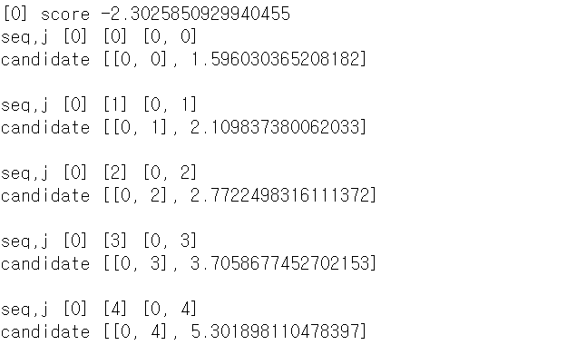
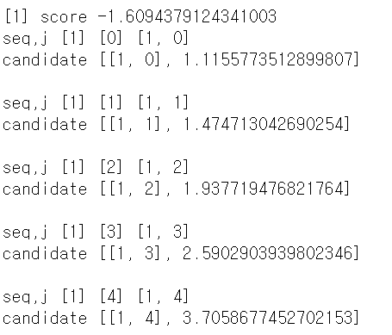
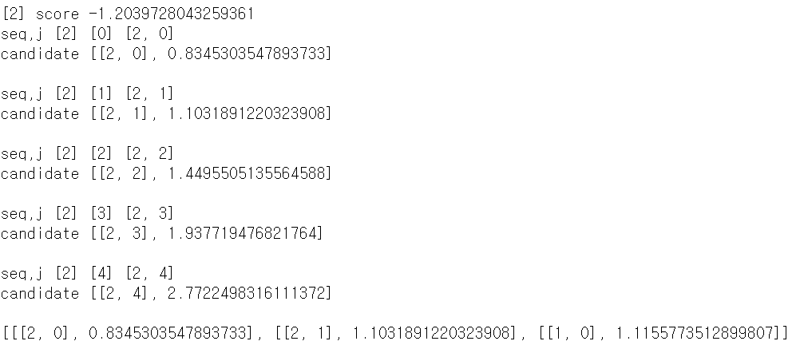
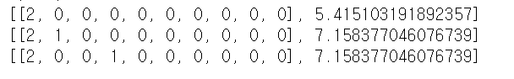
Beam Search
Notes:
https://mobicon.tistory.com/537 -> 사진 참조
1) validate() 에서 val 데이터셋에서 prediction한 문장 hypothesis와 score 결과를 저장하고, 상위 10%, 하위10% 출력

Slide 17
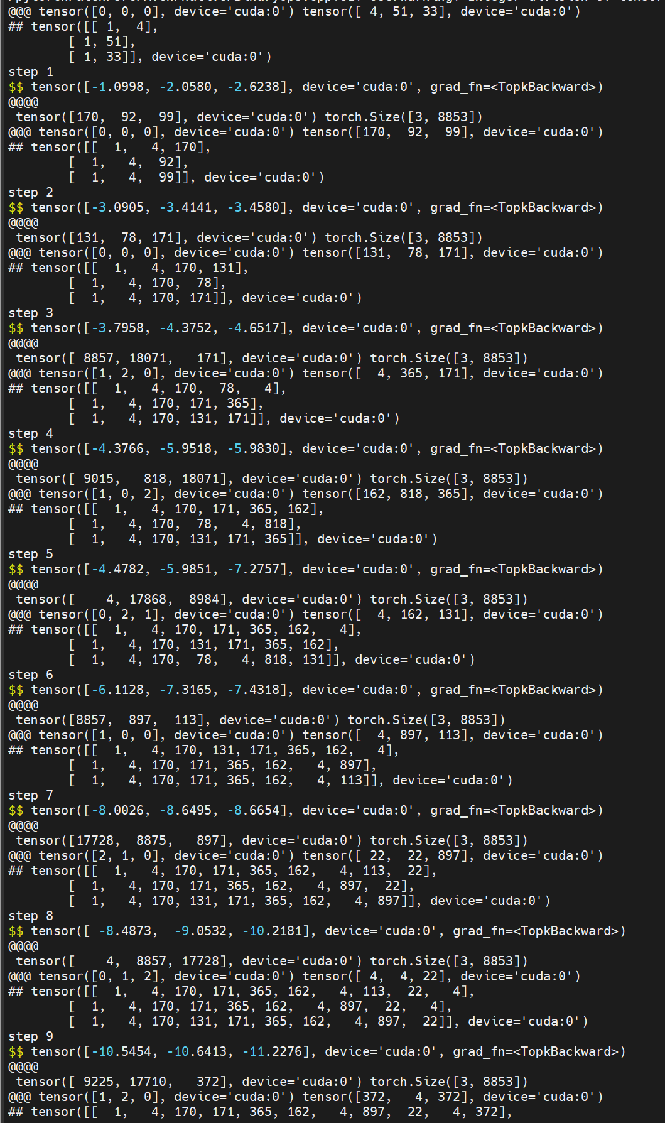
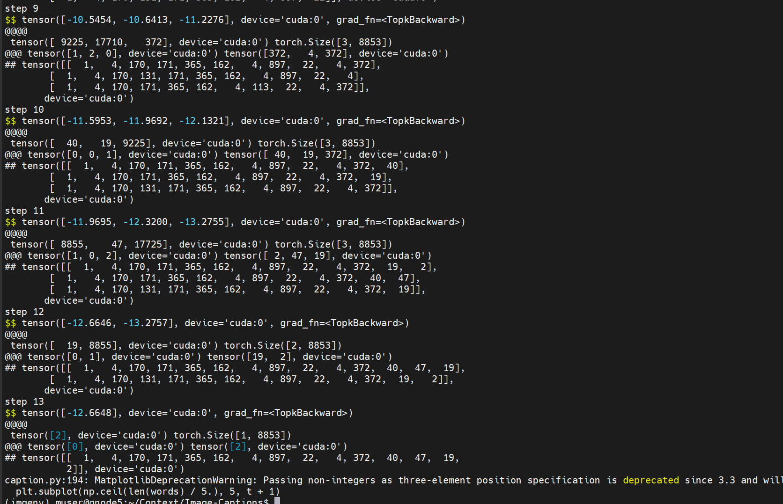
Image-caption beam search print
Notes:
https://mobicon.tistory.com/537 -> 사진 참조
1) validate() 에서 val 데이터셋에서 prediction한 문장 hypothesis와 score 결과를 저장하고, 상위 10%, 하위10% 출력

Slide 19
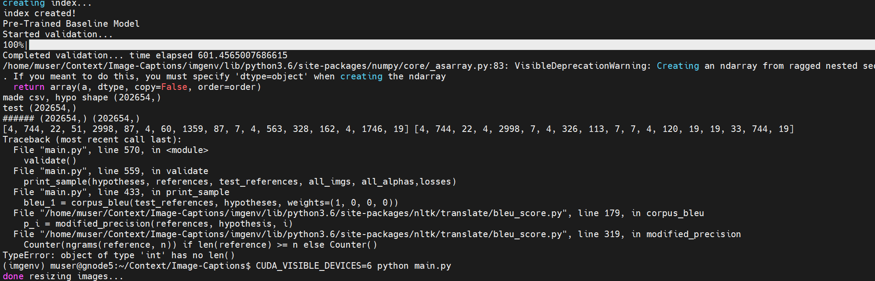

Slide 20
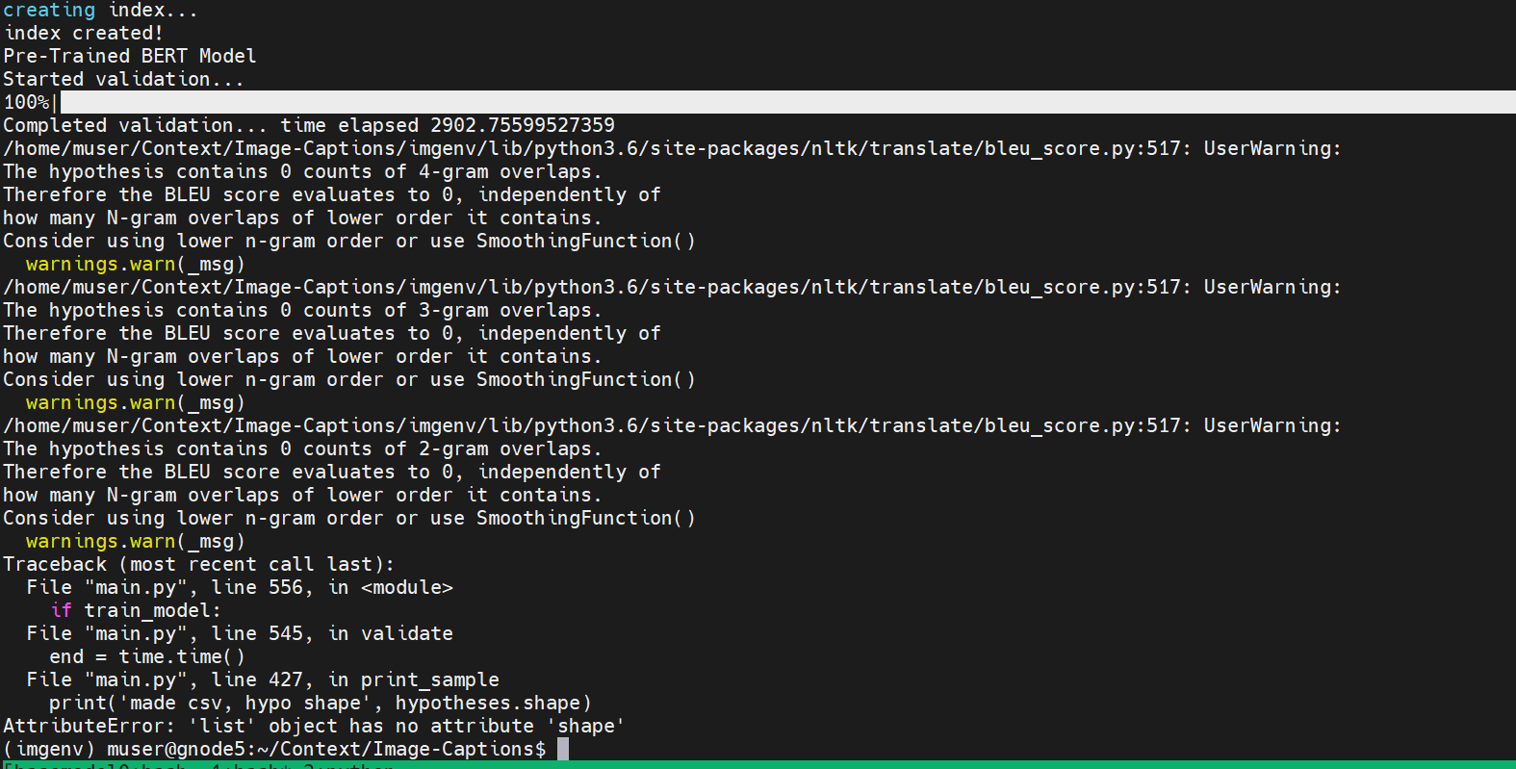
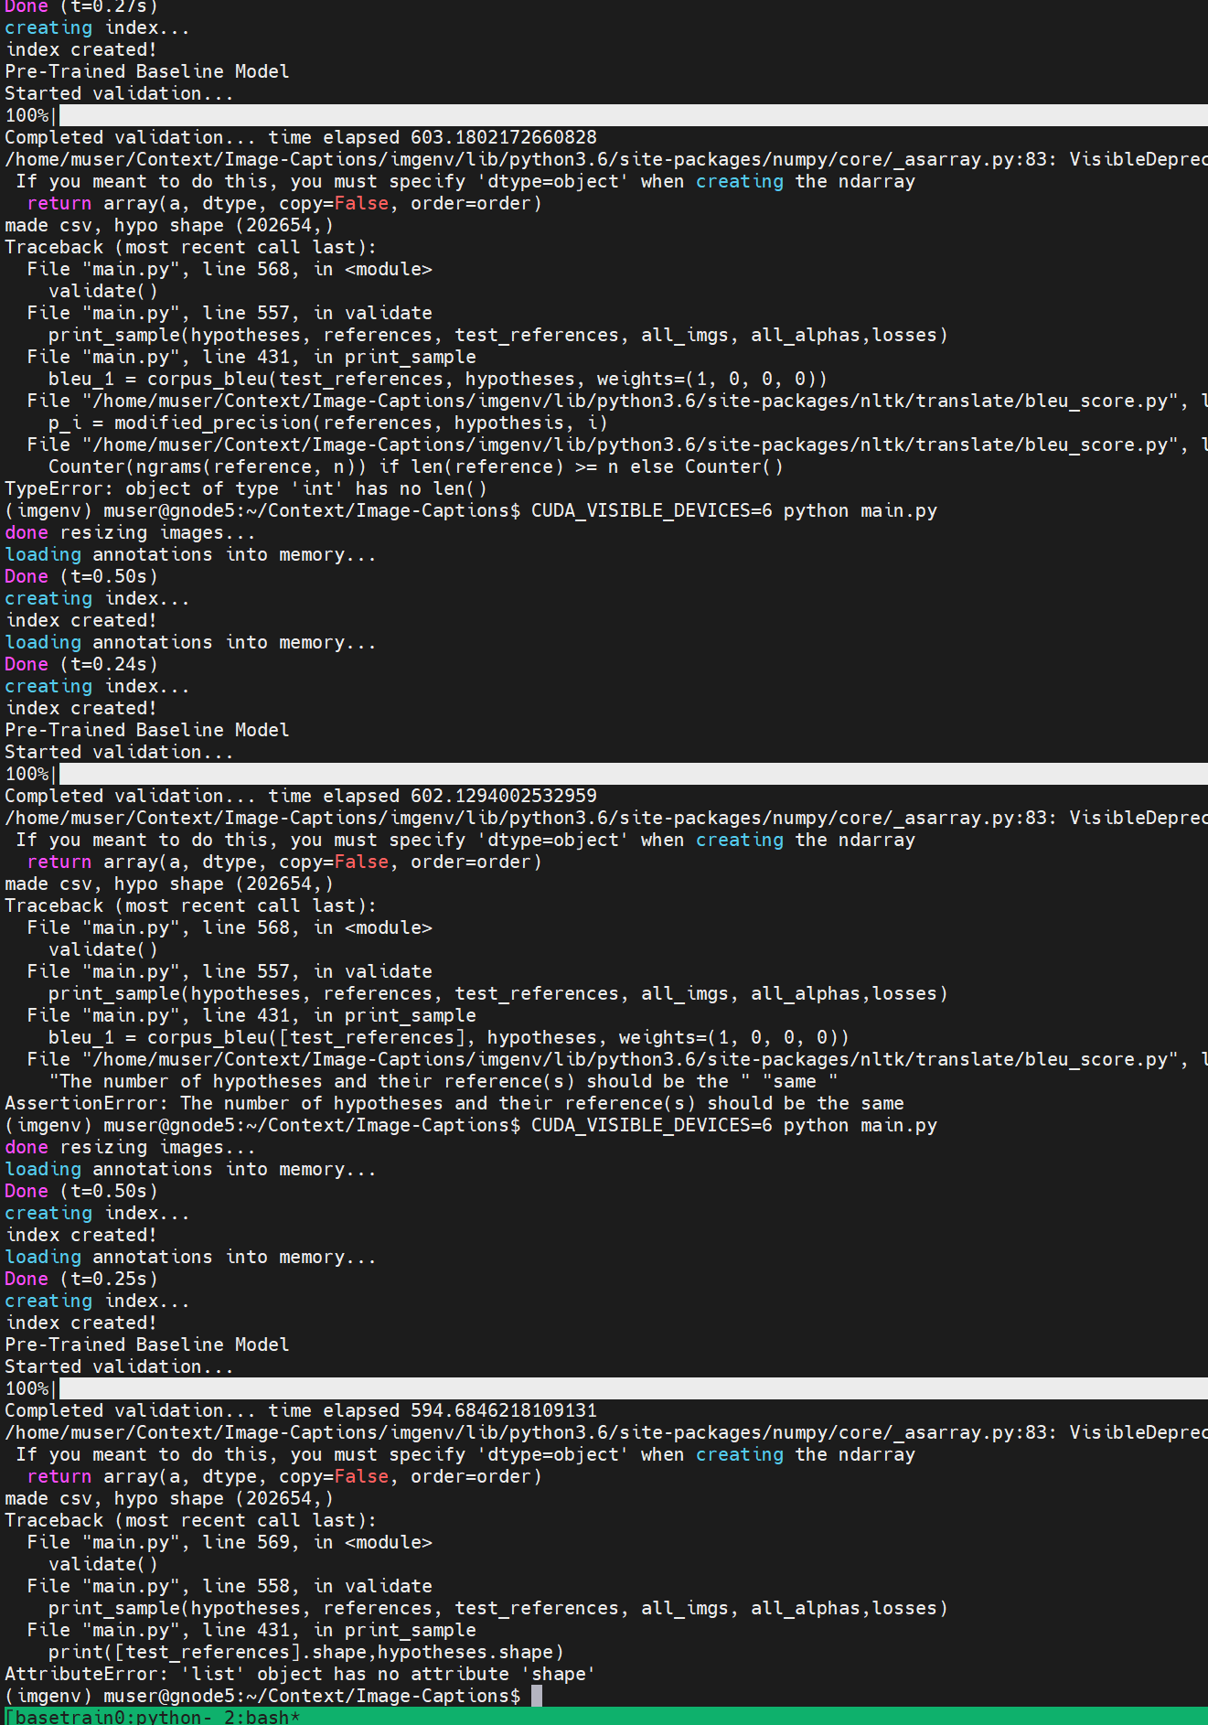
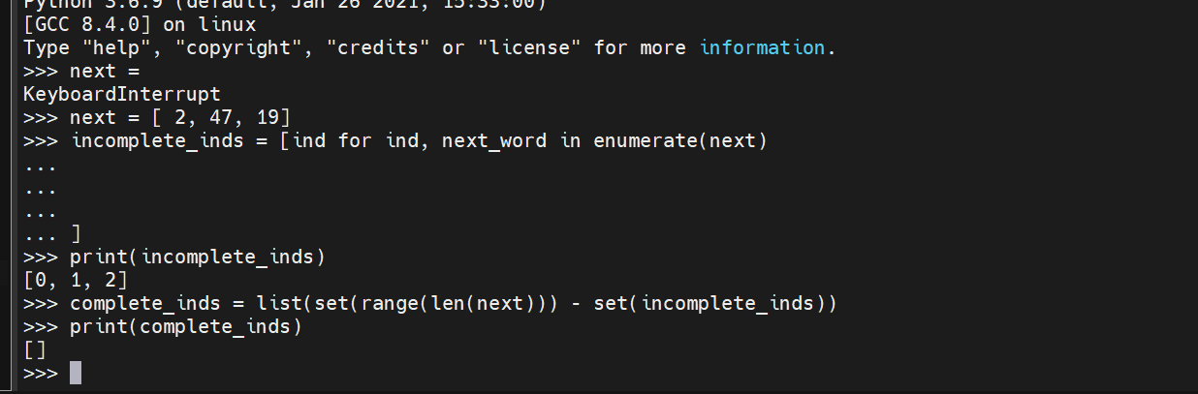
incomplete_inds = [ind for ind, next_word in enumerate(next)
complete_inds = list(set(range(len(next))) - set(incomplete_inds))

Slide 21
